Slide 1
Random Networks

Slide 2
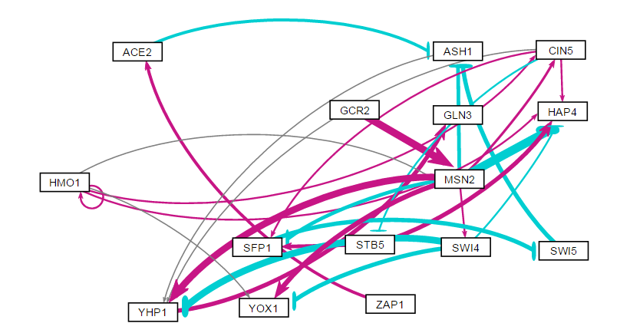
DB5: HAP4 Derived Family

Slide 3
DB5: HAP4 Derived Family
id | indegree | outdegree | degree | weighted indegree | weighted outdegree | weighted degree | eccentricity | closnesscentrality | harmonicclosnesscentrality | betweenesscentrality | modularity_class | pageranks | strongcompnum | clustering | eigencentrality
ACE2 | 1 | 1 | 2 | 0.916774 | -0.92164 | -0.00487 | 3 | 0.5 | 0.611111 | 3 | 0 | 0.048161 | 3 | 0 | 0.008418
ASH1 | 3 | 1 | 4 | -4.23118 | 0.102765 | -4.12842 | 2 | 0.666667 | 0.75 | 10 | 0 | 0.135297 | 2 | 0.083333 | 0.575118
CIN5 | 2 | 4 | 6 | 1.100237 | 0.649788 | 1.750026 | 3 | 0.636364 | 0.761905 | 5 | 1 | 0.037853 | 8 | 0.233333 | 0.249597
GCR2 | 0 | 1 | 1 | 0 | 3.224297 | 3.224297 | 3 | 0.458333 | 0.5 | 0 | 0 | 0.026026 | 12 | 0 | 0
GLN3 | 1 | 0 | 1 | 1.798596 | 0 | 1.798596 | 0 | 0 | 0 | 0 | 0 | 0.166009 | 0 | 0 | 0.8377
HAP4 | 5 | 0 | 5 | -1.66861 | 0 | -1.66861 | 0 | 0 | 0 | 0 | 1 | 0.069592 | 6 | 0.25 | 0.861994
HMO1 | 1 | 5 | 6 | 0.53869 | 1.548213 | 2.086903 | 3 | 0.55 | 0.651515 | 0 | 1 | 0.031358 | 13 | 0.4 | 0.11352
MSN2 | 2 | 7 | 9 | 3.324807 | -0.86569 | 2.459112 | 2 | 0.769231 | 0.85 | 14 | 0 | 0.053494 | 11 | 0.138889 | 0.121938
SFP1 | 3 | 1 | 4 | 0.577645 | -1.79677 | -1.21912 | 4 | 0.4 | 0.520833 | 9 | 1 | 0.055045 | 5 | 0.166667 | 0.605438
STB5 | 1 | 2 | 3 | -0.23575 | 3.240658 | 3.004904 | 5 | 0.375 | 0.547222 | 0 | 1 | 0.034069 | 7 | 0.333333 | 0.248138
SWI4 | 1 | 3 | 4 | 0.43188 | -4.88685 | -4.45497 | 2 | 0.8 | 0.875 | 0 | 1 | 0.032521 | 10 | 0.25 | 0.136077
SWI5 | 1 | 1 | 2 | -1.79677 | -1.77357 | -3.57034 | 3 | 0.5 | 0.611111 | 7 | 0 | 0.072795 | 4 | 0 | 0.52969
YHP1 | 4 | 1 | 5 | 0.031882 | 1.798596 | 1.830478 | 1 | 1 | 1 | 11 | 0 | 0.164686 | 1 | 0.15 | 1
YOX1 | 3 | 0 | 3 | 0.448366 | 0 | 0.448366 | 0 | 0 | 0 | 0 | 0 | 0.047068 | 9 | 0.333333 | 0.392633
ZAP1 | 0 | 1 | 1 | 0 | 0.916774 | 0.916774 | 4 | 0.4 | 0.520833 | 0 | 0 | 0.026026 | 14 | 0 | 0

Slide 4
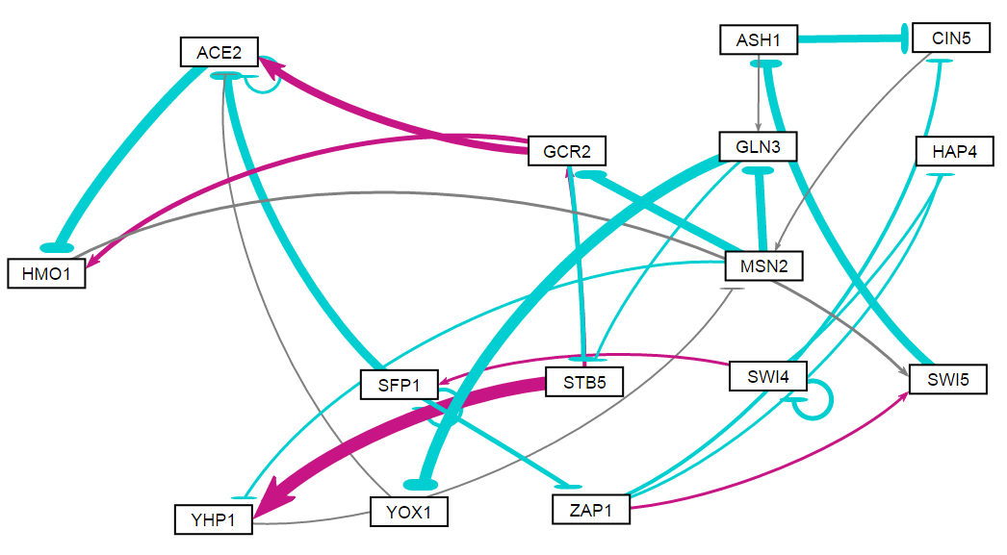
Random 1

Slide 5
Random 1
id | indegree | outdegree | degree | weighted indegree | weighted outdegree | weighted degree | eccentricity | closnesscentrality | harmonicclosnesscentrality | betweenesscentrality | modularity_class | pageranks | strongcompnum | clustering | eigencentrality
ACE2 | 4 | 2 | 6 | -0.67148656 | -3.32327351 | -3.9947601 | 6 | 0.243902 | 0.326667 | 14 | 0 | 0.1352 | 0 | 0.25 | 1
ASH1 | 1 | 2 | 3 | -2.28517461 | -2.073799834 | -4.3589744 | 5 | 0.384615 | 0.495 | 40 | 1 | 0.089497 | 0 | 0 | 0.247175
CIN5 | 2 | 1 | 3 | -2.93791199 | 0.004928011 | -2.932984 | 5 | 0.357143 | 0.428333 | 27 | 1 | 0.054088 | 0 | 0 | 0.213441
GCR2 | 2 | 3 | 5 | -1.73065788 | 2.036084175 | 0.3054263 | 5 | 0.384615 | 0.536667 | 27.5 | 0 | 0.073736 | 0 | 0.083333 | 0.438201
GLN3 | 2 | 2 | 4 | -2.46743225 | -3.657041073 | -6.1244733 | 6 | 0.344828 | 0.478333 | 30.5 | 1 | 0.083125 | 0 | 0 | 0.335908
HAP4 | 2 | 0 | 2 | -0.49384029 | 0 | -0.4938403 | 0 | 0 | 0 | 0 | 1 | 0.020479 | 1 | 0 | 0.125413
HMO1 | 2 | 1 | 3 | -1.85471809 | 0.195487455 | -1.6592306 | 5 | 0.277778 | 0.351667 | 36 | 1 | 0.089526 | 0 | 0.166667 | 0.773239
MSN2 | 2 | 3 | 5 | -0.06064875 | -5.312926799 | -5.3735755 | 5 | 0.434783 | 0.578333 | 40 | 1 | 0.119906 | 0 | 0 | 0.367813
SFP1 | 2 | 3 | 5 | -0.38283867 | -4.0165295 | -4.3993682 | 5 | 0.342105 | 0.447436 | 12 | 1 | 0.02173 | 3 | 0.25 | 0.160598
STB5 | 2 | 2 | 4 | -1.55076993 | 4.762393892 | 3.211624 | 5 | 0.37037 | 0.486667 | 14 | 2 | 0.067433 | 0 | 0 | 0.424644
SWI4 | 1 | 3 | 4 | -1.17737782 | -1.127476215 | -2.304854 | 6 | 0.28 | 0.388095 | 0 | 1 | 0.015573 | 4 | 0.333333 | 0.040533
SWI5 | 2 | 1 | 3 | 0.443576545 | -2.285174608 | -1.8415981 | 5 | 0.322581 | 0.395 | 43 | 1 | 0.092131 | 0 | 0 | 0.478266
YHP1 | 2 | 1 | 3 | 3.727512091 | -0.065576762 | 3.6619353 | 6 | 0.3125 | 0.395 | 6 | 2 | 0.073736 | 0 | 0 | 0.438201
YOX1 | 1 | 1 | 2 | -3.28500199 | -0.156118959 | -3.441121 | 7 | 0.217391 | 0.310238 | 7 | 0 | 0.046523 | 0 | 0 | 0.186139
ZAP1 | 1 | 3 | 4 | -1.04708886 | -0.754835308 | -1.8019242 | 4 | 0.375 | 0.5 | 19 | 1 | 0.017317 | 2 | 0 | 0.120065

Slide 6
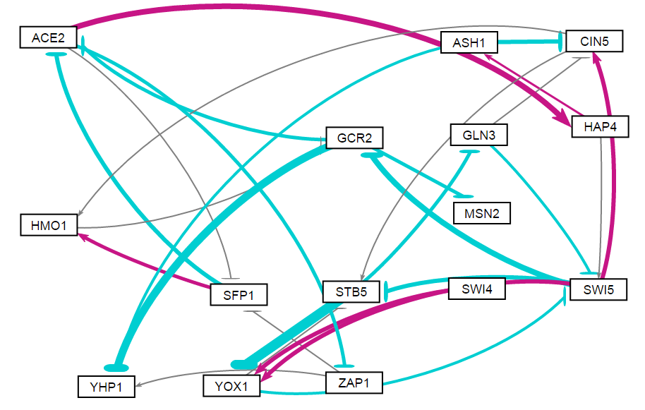
Random 2

Slide 7
Random 2
id | indegree | outdegree | degree | weighted indegree | weighted outdegree | weighted degree | eccentricity | closnesscentrality | harmonicclosnesscentrality | betweenesscentrality | modularity_class | pageranks | strongcompnum | clustering | eigencentrality
ACE2 | 2 | 3 | 5 | -3.69091 | 1.523667 | -2.16724 | 4 | 0.419355 | 0.525641 | 63.5 | 1 | 0.066865 | 2 | 0.083333 | 0.440975
ASH1 | 1 | 2 | 3 | 0.71898 | -3.10934 | -2.39036 | 5 | 0.309524 | 0.411538 | 4.5 | 1 | 0.031933 | 2 | 0 | 0.111769
CIN5 | 3 | 2 | 5 | -0.16546 | 0.023999 | -0.14146 | 5 | 0.351351 | 0.444872 | 17.5 | 6 | 0.080549 | 2 | 0.15 | 0.608482
GCR2 | 2 | 3 | 5 | -3.10622 | -7.83066 | -10.9369 | 5 | 0.371429 | 0.496154 | 66.5 | 1 | 0.100546 | 2 | 0 | 0.562213
GLN3 | 1 | 2 | 3 | -1.77136 | -1.21123 | -2.98258 | 5 | 0.361111 | 0.457692 | 7.5 | 0 | 0.066308 | 2 | 0.5 | 0.468011
HAP4 | 1 | 2 | 3 | 3.280873 | 0.793239 | 4.074113 | 4 | 0.40625 | 0.487179 | 37 | 1 | 0.035722 | 2 | 0 | 0.219243
HMO1 | 2 | 1 | 3 | 1.850663 | -0.01456 | 1.836099 | 6 | 0.288889 | 0.366667 | 19.5 | 3 | 0.072621 | 2 | 0 | 0.462455
MSN2 | 1 | 0 | 1 | -1.37216 | 0 | -1.37216 | 0 | 0 | 0 | 0 | 2 | 0.04523 | 1 | 0 | 0.27081
SFP1 | 2 | 2 | 4 | -0.22638 | -0.2024 | -0.42879 | 5 | 0.351351 | 0.444872 | 14 | 3 | 0.050894 | 2 | 0.166667 | 0.331011
STB5 | 3 | 2 | 5 | -2.0691 | -8.2287 | -10.2978 | 6 | 0.288889 | 0.398718 | 15 | 4 | 0.116604 | 2 | 0.416667 | 1
SWI4 | 0 | 1 | 1 | 0 | 2.166253 | 2.166253 | 6 | 0.27451 | 0.340476 | 0 | 5 | 0.016761 | 3 | 0 | 0
SWI5 | 3 | 4 | 7 | -2.17274 | -0.543 | -2.71574 | 4 | 0.481481 | 0.596154 | 65 | 6 | 0.103664 | 2 | 0.166667 | 0.703253
YHP1 | 3 | 0 | 3 | -5.65952 | 0 | -5.65952 | 0 | 0 | 0 | 0 | 7 | 0.073986 | 0 | 0 | 0.445655
YOX1 | 3 | 2 | 5 | -2.04047 | -1.35495 | -3.39542 | 5 | 0.351351 | 0.444872 | 18.5 | 5 | 0.102595 | 2 | 0.166667 | 0.803507
ZAP1 | 1 | 2 | 3 | -1.55675 | 0.007134 | -1.54961 | 6 | 0.288889 | 0.398718 | 1.5 | 7 | 0.035722 | 2 | 0.333333 | 0.219243

Slide 8
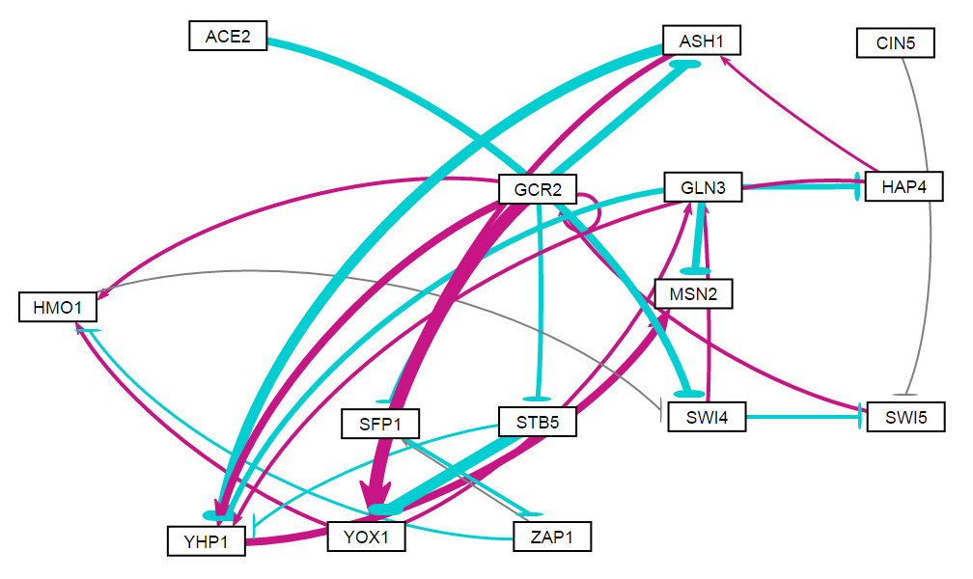
Random 3

Slide 9
Random 3
id | indegree | outdegree | degree | weighted indegree | weighted outdegree | weighted degree | eccentricity | closnesscentrality | harmonicclosnesscentrality | betweenesscentrality | modularity_class | pageranks | strongcompnum | clustering | eigencentrality
ACE2 | 0 | 1 | 1 | 0 | -2.5119 | -2.5119 | 5 | 0.309524 | 0.367949 | 0 | 0 | 0.01729 | 3 | 0 | 0
ASH1 | 2 | 2 | 4 | -2.8402 | -2.06334 | -4.90353 | 7 | 0.285714 | 0.424405 | 17 | 3 | 0.046216 | 2 | 0.25 | 0.36897
CIN5 | 0 | 1 | 1 | 0 | -0.05264 | -0.05264 | 5 | 0.309524 | 0.361538 | 0 | 1 | 0.01729 | 4 | 0 | 0
GCR2 | 2 | 7 | 9 | 2.002912 | 3.96889 | 5.971802 | 3 | 0.6 | 0.722222 | 56.5 | 2 | 0.092338 | 2 | 0.214286 | 0.343231
GLN3 | 2 | 3 | 5 | 2.084409 | -6.38487 | -4.30046 | 9 | 0.218182 | 0.412831 | 27.5 | 6 | 0.086039 | 2 | 0.1 | 0.528114
HAP4 | 1 | 2 | 3 | -1.90475 | 1.466447 | -0.4383 | 8 | 0.244898 | 0.391171 | 13.5 | 2 | 0.041656 | 2 | 0.333333 | 0.294356
HMO1 | 3 | 1 | 4 | 1.319721 | -0.13433 | 1.185392 | 5 | 0.315789 | 0.377778 | 53 | 2 | 0.08175 | 2 | 0.083333 | 0.641156
MSN2 | 2 | 0 | 2 | 0.078709 | 0 | 0.078709 | 0 | 0 | 0 | 0 | 2 | 0.12865 | 0 | 0.5 | 0.850167
SFP1 | 2 | 1 | 3 | -1.0272 | -1.1192 | -2.1464 | 6 | 0.230769 | 0.302778 | 11 | 4 | 0.05614 | 2 | 0 | 0.325619
STB5 | 1 | 2 | 3 | -1.59559 | -4.74318 | -6.33876 | 7 | 0.3 | 0.431349 | 0 | 5 | 0.028505 | 2 | 0.333333 | 0.208734
SWI4 | 2 | 2 | 4 | -2.64623 | 0.106603 | -2.53962 | 4 | 0.413793 | 0.493056 | 66 | 6 | 0.101438 | 2 | 0 | 0.37213
SWI5 | 2 | 1 | 3 | -0.88594 | 0.993672 | 0.107733 | 4 | 0.413793 | 0.465278 | 56.5 | 2 | 0.075125 | 2 | 0 | 0.218135
YHP1 | 5 | 1 | 6 | -2.49857 | 2.922426 | 0.423859 | 1 | 1 | 1 | 6 | 2 | 0.102331 | 1 | 0.166667 | 1
YOX1 | 3 | 2 | 5 | 2.986827 | 1.994548 | 4.981375 | 6 | 0.333333 | 0.456944 | 39 | 2 | 0.060253 | 2 | 0.15 | 0.545409
ZAP1 | 1 | 2 | 3 | -1.1192 | -0.48822 | -1.60742 | 5 | 0.292683 | 0.397222 | 11 | 4 | 0.06498 | 2 | 0 | 0.19483

Slide 10
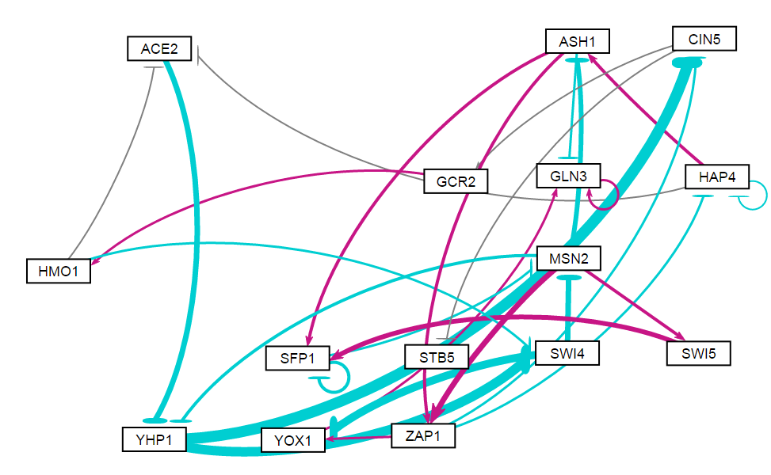
Random 4

Slide 11
Random 4
id | indegree | outdegree | degree | weighted indegree | weighted outdegree | weighted degree | eccentricity | closnesscentrality | harmonicclosnesscentrality | betweenesscentrality | modularity_class | pageranks | strongcompnum | clustering | eigencentrality
ACE2 | 2 | 1 | 3 | -0.27687 | -2.24722 | -2.52409 | 5 | 0.297872 | 0.355952 | 13.5 | 0 | 0.03682 | 3 | 0 | 0.348374
ASH1 | 2 | 3 | 5 | -0.74146 | 0.941283 | 0.199823 | 4 | 0.411765 | 0.511905 | 17.5 | 2 | 0.034553 | 3 | 0.15 | 0.566579
CIN5 | 2 | 2 | 4 | -5.5222 | 0.02488 | -5.49732 | 6 | 0.259259 | 0.360714 | 31.5 | 0 | 0.046221 | 3 | 0 | 0.528327
GCR2 | 1 | 1 | 2 | 0.169878 | 0.428047 | 0.597925 | 5 | 0.285714 | 0.346429 | 22.5 | 0 | 0.031436 | 3 | 0 | 0.264983
GLN3 | 3 | 1 | 4 | 0.191316 | 0.346954 | 0.53827 | 0 | 0 | 0 | 0 | 1 | 0.392785 | 0 | 0.333333 | 1
HAP4 | 2 | 3 | 5 | -0.67391 | 0.36154 | -0.31237 | 5 | 0.358974 | 0.44881 | 11.5 | 2 | 0.030561 | 3 | 0.333333 | 0.556787
HMO1 | 1 | 2 | 3 | 0.428047 | -0.34845 | 0.079602 | 4 | 0.358974 | 0.440476 | 25.5 | 0 | 0.038515 | 3 | 0 | 0.134791
MSN2 | 2 | 4 | 6 | -2.66814 | 0.424619 | -2.24352 | 4 | 0.482759 | 0.589286 | 66 | 1 | 0.066353 | 3 | 0.133333 | 0.582883
SFP1 | 3 | 2 | 5 | 1.782031 | -1.39 | 0.392035 | 5 | 0.341463 | 0.40119 | 21 | 2 | 0.075851 | 3 | 0.416667 | 0.836881
STB5 | 1 | 0 | 1 | -0.145 | 0 | -0.145 | 0 | 0 | 0 | 0 | 3 | 0.031436 | 2 | 0 | 0.264983
SWI4 | 2 | 2 | 4 | -4.70823 | -5.6903 | -10.3985 | 5 | 0.368421 | 0.460714 | 40 | 0 | 0.05248 | 3 | 0.083333 | 0.319914
SWI5 | 1 | 1 | 2 | 0.747813 | 1.893985 | 2.641798 | 6 | 0.264151 | 0.322619 | 3.5 | 2 | 0.025891 | 3 | 0.5 | 0.293092
YHP1 | 2 | 2 | 4 | -3.19325 | -9.54807 | -12.7413 | 4 | 0.378378 | 0.458333 | 33.5 | 1 | 0.0572 | 3 | 0.083333 | 0.475659
YOX1 | 2 | 1 | 3 | -3.11409 | 0.356019 | -2.75808 | 1 | 1 | 1 | 7 | 1 | 0.044213 | 1 | 0 | 0.457364
ZAP1 | 2 | 3 | 5 | 2.936006 | -0.34135 | 2.594655 | 5 | 0.4 | 0.514286 | 34 | 1 | 0.035686 | 3 | 0.1 | 0.573185

Slide 12
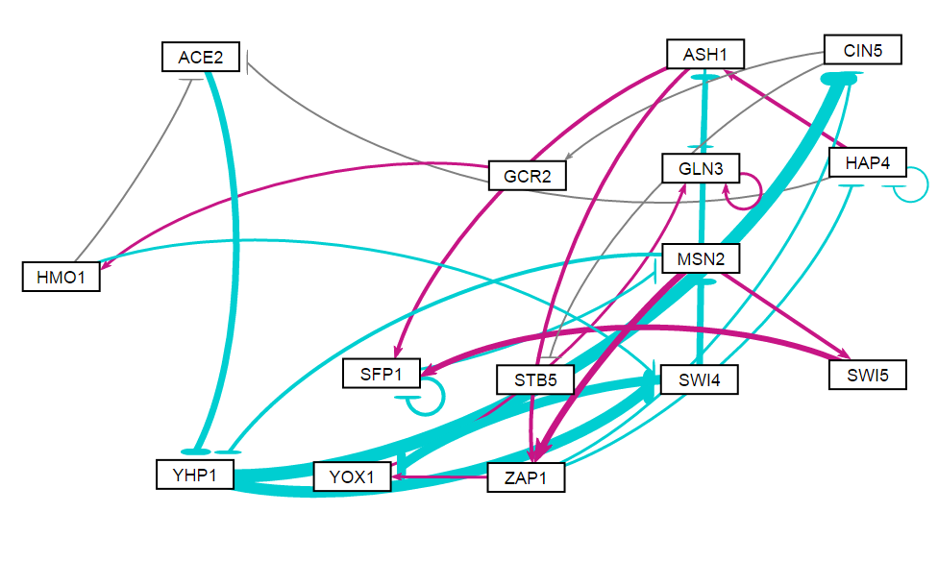
Random 5

Slide 13
Random 5
id | indegree | outdegree | degree | weighted indegree | weighted outdegree | weighted degree | eccentricity | closnesscentrality | harmonicclosnesscentrality | betweenesscentrality | modularity_class | pageranks | strongcompnum | clustering | eigencentrality
ACE2 | 2 | 1 | 3 | -0.27687 | -2.24722 | -2.52409 | 5 | 0.297872 | 0.355952 | 13.5 | 0 | 0.03682 | 3 | 0 | 0.348374
ASH1 | 2 | 3 | 5 | -0.74146 | 0.941283 | 0.199823 | 4 | 0.411765 | 0.511905 | 17.5 | 3 | 0.034553 | 3 | 0.15 | 0.566579
CIN5 | 2 | 2 | 4 | -5.5222 | 0.02488 | -5.49732 | 6 | 0.259259 | 0.360714 | 31.5 | 0 | 0.046221 | 3 | 0 | 0.528327
GCR2 | 1 | 1 | 2 | 0.169878 | 0.428047 | 0.597925 | 5 | 0.285714 | 0.346429 | 22.5 | 0 | 0.031436 | 3 | 0 | 0.264983
GLN3 | 3 | 1 | 4 | 0.191316 | 0.346954 | 0.53827 | 0 | 0 | 0 | 0 | 1 | 0.392785 | 0 | 0.333333 | 1
HAP4 | 2 | 3 | 5 | -0.67391 | 0.36154 | -0.31237 | 5 | 0.358974 | 0.44881 | 11.5 | 3 | 0.030561 | 3 | 0.333333 | 0.556787
HMO1 | 1 | 2 | 3 | 0.428047 | -0.34845 | 0.079602 | 4 | 0.358974 | 0.440476 | 25.5 | 0 | 0.038515 | 3 | 0 | 0.134791
MSN2 | 2 | 4 | 6 | -2.66814 | 0.424619 | -2.24352 | 4 | 0.482759 | 0.589286 | 66 | 1 | 0.066353 | 3 | 0.133333 | 0.582883
SFP1 | 3 | 2 | 5 | 1.782031 | -1.39 | 0.392035 | 5 | 0.341463 | 0.40119 | 21 | 3 | 0.075851 | 3 | 0.416667 | 0.836881
STB5 | 1 | 0 | 1 | -0.145 | 0 | -0.145 | 0 | 0 | 0 | 0 | 2 | 0.031436 | 2 | 0 | 0.264983
SWI4 | 2 | 2 | 4 | -4.70823 | -5.6903 | -10.3985 | 5 | 0.368421 | 0.460714 | 40 | 0 | 0.05248 | 3 | 0.083333 | 0.319914
SWI5 | 1 | 1 | 2 | 0.747813 | 1.893985 | 2.641798 | 6 | 0.264151 | 0.322619 | 3.5 | 3 | 0.025891 | 3 | 0.5 | 0.293092
YHP1 | 2 | 2 | 4 | -3.19325 | -9.54807 | -12.7413 | 4 | 0.378378 | 0.458333 | 33.5 | 1 | 0.0572 | 3 | 0.083333 | 0.475659
YOX1 | 2 | 1 | 3 | -3.11409 | 0.356019 | -2.75808 | 1 | 1 | 1 | 7 | 1 | 0.044213 | 1 | 0 | 0.457364
ZAP1 | 2 | 3 | 5 | 2.936006 | -0.34135 | 2.594655 | 5 | 0.4 | 0.514286 | 34 | 1 | 0.035686 | 3 | 0.1 | 0.573185

Slide 14
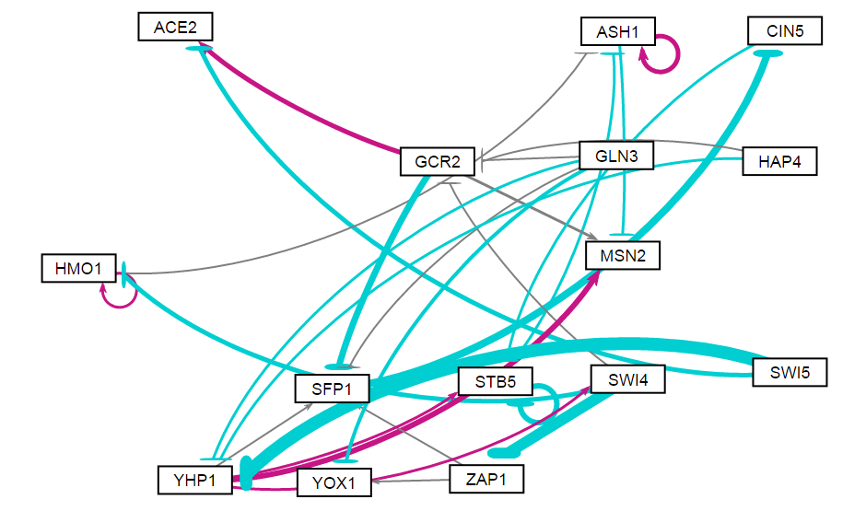
Random 6

Slide 15
Random 6
id | indegree | outdegree | degree | weighted indegree | weighted outdegree | weighted degree | eccentricity | closnesscentrality | harmonicclosnesscentrality | betweenesscentrality | modularity_class | pageranks | strongcompnum | clustering | eigencentrality
ACE2 | 2 | 0 | 2 | 0.228821 | 0 | 0.228821 | 0 | 0 | 0 | 0 | 2 | 0.044543 | 0 | 0 | 0.080503
ASH1 | 3 | 2 | 5 | 1.026698 | 0.927798 | 1.954496 | 1 | 1 | 1 | 5 | 0 | 0.202631 | 2 | 0.25 | 1
CIN5 | 1 | 1 | 2 | -3.34808 | -0.31525 | -3.66333 | 3 | 0.5 | 0.611111 | 9 | 1 | 0.075684 | 4 | 0 | 0.172016
GCR2 | 3 | 3 | 6 | -0.52193 | -0.47461 | -0.99654 | 4 | 0.5 | 0.680556 | 8.5 | 2 | 0.045443 | 6 | 0.033333 | 0.063124
GLN3 | 0 | 4 | 4 | 0 | -1.99813 | -1.99813 | 3 | 0.521739 | 0.625 | 0 | 5 | 0.022218 | 12 | 0.166667 | 0
HAP4 | 0 | 2 | 2 | 0 | -0.75507 | -0.75507 | 4 | 0.428571 | 0.506944 | 0 | 3 | 0.022218 | 13 | 0 | 0
HMO1 | 2 | 2 | 4 | -0.89461 | 0.4209 | -0.47371 | 2 | 0.666667 | 0.75 | 1 | 0 | 0.054414 | 9 | 0.333333 | 0.196847
MSN2 | 3 | 0 | 3 | 1.528113 | 0 | 1.528113 | 0 | 0 | 0 | 0 | 5 | 0.130892 | 1 | 0 | 0.653262
SFP1 | 4 | 1 | 5 | -2.19561 | -3.34808 | -5.54369 | 4 | 0.4 | 0.520833 | 13 | 5 | 0.062861 | 5 | 0.1 | 0.172512
STB5 | 3 | 2 | 5 | -1.64387 | -2.53644 | -4.1803 | 2 | 0.666667 | 0.75 | 11 | 5 | 0.167574 | 3 | 0.25 | 0.491579
SWI4 | 1 | 3 | 4 | 0.476639 | -6.68668 | -6.21004 | 4 | 0.5 | 0.608333 | 14 | 5 | 0.03196 | 10 | 0 | 0.039919
SWI5 | 0 | 2 | 2 | 0 | -7.62053 | -7.62053 | 4 | 0.413793 | 0.493056 | 0 | 4 | 0.022218 | 14 | 0 | 0
YHP1 | 3 | 4 | 7 | -7.30562 | 3.305232 | -4.00039 | 3 | 0.55 | 0.651515 | 23 | 5 | 0.045828 | 11 | 0.02381 | 0.01621
YOX1 | 2 | 0 | 2 | -1.11987 | 0 | -1.11987 | 0 | 0 | 0 | 0 | 6 | 0.040238 | 7 | 0 | 0.057493
ZAP1 | 1 | 2 | 3 | -5.16368 | 0.147858 | -5.01582 | 5 | 0.375 | 0.547222 | 5.5 | 6 | 0.031277 | 8 | 0 | 0.052318

Slide 16
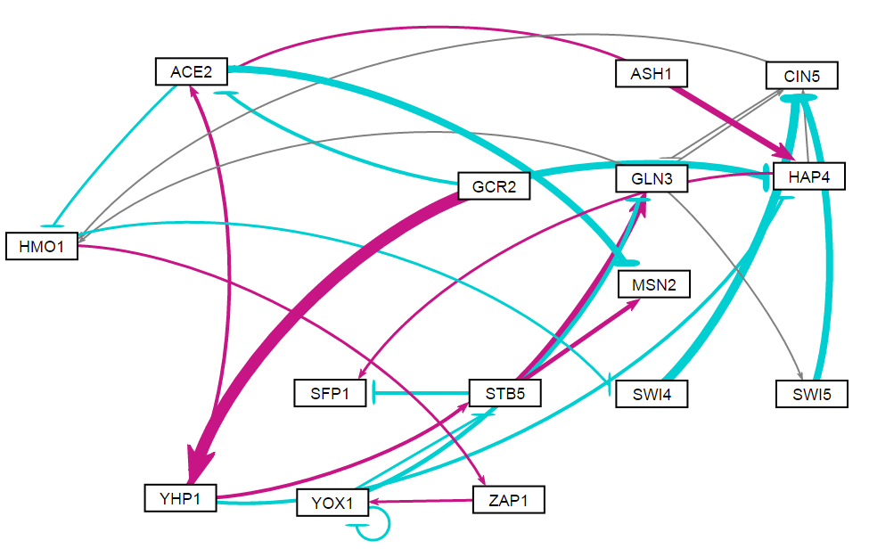
Random 7

Slide 17
Random 7
id | indegree | outdegree | degree | weighted indegree | weighted outdegree | weighted degree | eccentricity | closnesscentrality | harmonicclosnesscentrality | betweenesscentrality | modularity_class | pageranks | strongcompnum | clustering | eigencentrality
ACE2 | 3 | 2 | 5 | 0.171748 | -2.80768 | -2.63593 | 5 | 0.333333 | 0.456667 | 15.5 | 0 | 0.030635 | 3 | 0.05 | 0.026528
ASH1 | 0 | 2 | 2 | 0 | 2.478744 | 2.478744 | 5 | 0.375 | 0.475 | 0 | 1 | 0.014785 | 5 | 0 | 0
CIN5 | 4 | 2 | 6 | -6.06264 | 0.096636 | -5.966 | 5 | 0.36 | 0.498148 | 29 | 0 | 0.173223 | 2 | 0.15 | 0.977912
GCR2 | 0 | 3 | 3 | 0 | 1.277563 | 1.277563 | 4 | 0.433333 | 0.538462 | 0 | 2 | 0.014785 | 7 | 0.333333 | 0
GLN3 | 3 | 3 | 6 | 0.926862 | 0.550867 | 1.477729 | 5 | 0.375 | 0.553704 | 23 | 2 | 0.133544 | 2 | 0.15 | 0.888201
HAP4 | 3 | 2 | 5 | -1.20182 | 0.340208 | -0.86161 | 6 | 0.333333 | 0.461667 | 8.5 | 0 | 0.030635 | 4 | 0.05 | 0.026528
HMO1 | 3 | 2 | 5 | -0.0148 | 0.015599 | 8.03E-04 | 4 | 0.375 | 0.490741 | 52 | 0 | 0.139266 | 2 | 0.15 | 1
MSN2 | 2 | 0 | 2 | -1.0448 | 0 | -1.0448 | 0 | 0 | 0 | 0 | 0 | 0.04221 | 0 | 0 | 0.194279
SFP1 | 2 | 0 | 2 | -0.48936 | 0 | -0.48936 | 0 | 0 | 0 | 0 | 0 | 0.04221 | 1 | 0 | 0.194279
STB5 | 2 | 3 | 5 | 0.257914 | 2.9969 | 3.254815 | 4 | 0.473684 | 0.601852 | 20 | 2 | 0.050865 | 2 | 0.05 | 0.258746
SWI4 | 1 | 1 | 2 | -0.31876 | -3.57987 | -3.89863 | 6 | 0.28125 | 0.383333 | 4 | 0 | 0.073949 | 2 | 0.5 | 0.517702
SWI5 | 1 | 1 | 2 | 0.12262 | -2.7082 | -2.58558 | 6 | 0.28125 | 0.383333 | 0 | 0 | 0.052598 | 2 | 1 | 0.450405
YHP1 | 1 | 3 | 4 | 5.094504 | 1.104565 | 6.199069 | 4 | 0.461538 | 0.5625 | 2 | 2 | 0.018975 | 6 | 0.166667 | 0.005195
YOX1 | 2 | 3 | 5 | 0.073681 | -2.27701 | -2.20333 | 3 | 0.5 | 0.574074 | 30 | 0 | 0.108372 | 2 | 0.333333 | 0.498188
ZAP1 | 1 | 1 | 2 | 0.334356 | 0.361181 | 0.695537 | 4 | 0.375 | 0.435185 | 33 | 0 | 0.073949 | 2 | 0 | 0.517702

Slide 18
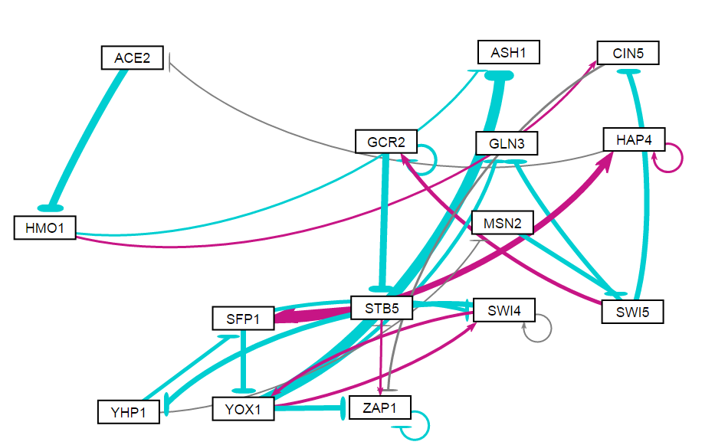
Random 8

Slide 19
Random 8
id | indegree | outdegree | degree | weighted indegree | weighted outdegree | weighted degree | eccentricity | closnesscentrality | harmonicclosnesscentrality | betweenesscentrality | modularity_class | pageranks | strongcompnum | clustering | eigencentrality
ACE2 | 1 | 1 | 2 | -0.08287 | -3.31993 | -3.4028 | 10 | 0.184211 | 0.27894 | 27 | 0 | 0.043505 | 2 | 0 | 0.166014
ASH1 | 2 | 0 | 2 | -5.3168 | 0 | -5.3168 | 0 | 0 | 0 | 0 | 3 | 0.049596 | 1 | 0 | 0.277455
CIN5 | 2 | 1 | 3 | -1.9592 | -0.231 | -2.1902 | 8 | 0.215385 | 0.284609 | 35 | 3 | 0.048584 | 2 | 0 | 0.089459
GCR2 | 2 | 2 | 4 | 0.281466 | -4.14395 | -3.86249 | 6 | 0.269231 | 0.338095 | 19.5 | 1 | 0.046021 | 2 | 0.333333 | 0.125521
GLN3 | 2 | 0 | 2 | -2.78242 | 0 | -2.78242 | 0 | 0 | 0 | 0 | 2 | 0.038956 | 0 | 0 | 0.270544
HAP4 | 2 | 2 | 4 | 2.880725 | 0.254367 | 3.135092 | 11 | 0.166667 | 0.258648 | 25 | 5 | 0.066991 | 2 | 0.333333 | 0.348401
HMO1 | 1 | 2 | 3 | -3.31993 | 0.036156 | -3.28378 | 9 | 0.205882 | 0.325879 | 29 | 3 | 0.052011 | 2 | 0 | 0.083488
MSN2 | 1 | 1 | 2 | -0.07782 | -1.77028 | -1.8481 | 7 | 0.245614 | 0.332823 | 25 | 4 | 0.029976 | 2 | 0 | 0.146744
SFP1 | 2 | 3 | 5 | 2.262438 | -0.73132 | 1.531117 | 5 | 0.4 | 0.514286 | 99 | 5 | 0.082868 | 2 | 0.15 | 0.399528
STB5 | 2 | 2 | 4 | -3.20411 | 4.052939 | 0.848825 | 6 | 0.318182 | 0.421429 | 84 | 5 | 0.124453 | 2 | 0 | 0.539981
SWI4 | 3 | 3 | 6 | -0.19919 | -1.44498 | -1.64417 | 5 | 0.368421 | 0.460714 | 41 | 6 | 0.071149 | 2 | 0.5 | 0.741632
SWI5 | 1 | 3 | 4 | -1.77028 | -2.42405 | -4.19433 | 6 | 0.285714 | 0.429762 | 27 | 1 | 0.040491 | 2 | 0 | 0.06996
YHP1 | 1 | 2 | 3 | -2.29336 | -1.2381 | -3.53145 | 4 | 0.388889 | 0.464286 | 38 | 4 | 0.035188 | 2 | 0.166667 | 0.329975
YOX1 | 2 | 4 | 6 | -1.25704 | -7.64585 | -8.9029 | 6 | 0.325581 | 0.495238 | 24 | 6 | 0.058674 | 2 | 0.05 | 0.512362
ZAP1 | 4 | 2 | 6 | -2.49429 | -0.72667 | -3.22096 | 7 | 0.245614 | 0.312585 | 48.5 | 3 | 0.211538 | 2 | 0.333333 | 1

Slide 20
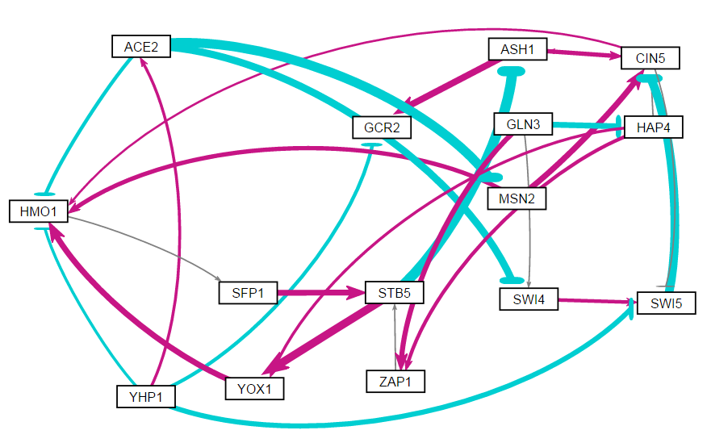
Random 9

Slide 21
Random 9
id | indegree | outdegree | degree | weighted indegree | weighted outdegree | weighted degree | eccentricity | closnesscentrality | harmonicclosnesscentrality | betweenesscentrality | modularity_class | pageranks | strongcompnum | clustering | eigencentrality
ACE2 | 1 | 3 | 4 | 0.74381 | -7.31831 | -6.5745 | 4 | 0.434783 | 0.566667 | 2 | 0 | 0.016567 | 4 | 0.166667 | 0.0062
ASH1 | 2 | 2 | 4 | -3.7727 | 3.661482 | -0.11122 | 5 | 0.388889 | 0.540476 | 22 | 0 | 0.113186 | 1 | 0 | 0.876402
CIN5 | 4 | 3 | 7 | -0.20655 | 0.492172 | 0.285627 | 4 | 0.5 | 0.654762 | 34 | 0 | 0.137826 | 1 | 0.05 | 1
GCR2 | 2 | 0 | 2 | 1.247202 | 0 | 1.247202 | 0 | 0 | 0 | 0 | 0 | 0.064631 | 0 | 0 | 0.521073
GLN3 | 0 | 3 | 3 | 0 | -0.13896 | -0.13896 | 4 | 0.44 | 0.560606 | 0 | 1 | 0.013664 | 7 | 0.166667 | 0
HAP4 | 1 | 3 | 4 | -1.87268 | 1.484408 | -0.38828 | 3 | 0.529412 | 0.62963 | 5 | 0 | 0.017535 | 6 | 0.083333 | 0.0062
HMO1 | 5 | 1 | 6 | 1.970845 | 0.030555 | 2.0014 | 5 | 0.318182 | 0.409524 | 31 | 1 | 0.135314 | 1 | 0.1 | 0.874675
MSN2 | 1 | 2 | 3 | -3.72316 | 3.433372 | -0.28979 | 4 | 0.444444 | 0.552083 | 3 | 0 | 0.018358 | 3 | 0.333333 | 0.02067
SFP1 | 1 | 1 | 2 | 0.030555 | 2.140688 | 2.171243 | 4 | 0.388889 | 0.464286 | 25 | 1 | 0.128612 | 1 | 0 | 0.57331
STB5 | 2 | 2 | 4 | 2.24742 | -0.95184 | 1.295582 | 3 | 0.5 | 0.595238 | 30 | 1 | 0.142288 | 1 | 0 | 0.404922
SWI4 | 2 | 1 | 3 | -2.52901 | 1.177022 | -1.35199 | 6 | 0.285714 | 0.379167 | 2 | 0 | 0.02223 | 2 | 0 | 0.02687
SWI5 | 3 | 1 | 4 | -0.57106 | -3.39417 | -3.96523 | 5 | 0.35 | 0.445238 | 9 | 0 | 0.074545 | 1 | 0 | 0.669955
YHP1 | 0 | 4 | 4 | 0 | -2.77097 | -2.77097 | 4 | 0.5 | 0.628788 | 0 | 0 | 0.013664 | 8 | 0.083333 | 0
YOX1 | 2 | 1 | 3 | 3.774609 | 1.86736 | 5.641969 | 6 | 0.269231 | 0.378571 | 7 | 1 | 0.079075 | 1 | 0 | 0.284887
ZAP1 | 2 | 1 | 3 | 2.480263 | 0.106732 | 2.586995 | 4 | 0.363636 | 0.4375 | 3 | 1 | 0.022504 | 5 | 0.166667 | 0.02687

Slide 22
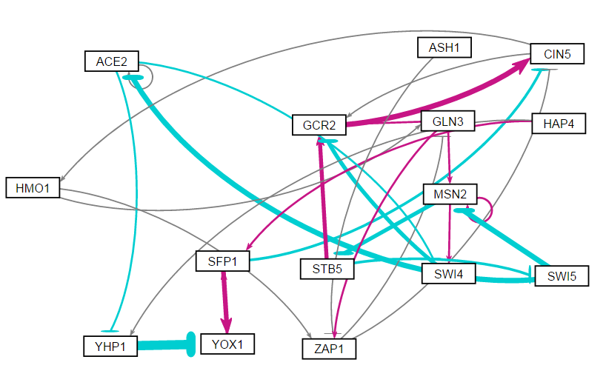
Random 10

Slide 23
Random 10
id | indegree | outdegree | degree | weighted indegree | weighted outdegree | weighted degree | eccentricity | closnesscentrality | harmonicclosnesscentrality | betweenesscentrality | modularity_class | pageranks | strongcompnum | clustering | eigencentrality
ACE2 | 2 | 3 | 5 | -2.93734 | -0.78149 | -3.71883 | 8 | 0.255319 | 0.395933 | 34.66667 | 3 | 0.026885 | 0 | 0.25 | 0.208295
ASH1 | 0 | 1 | 1 | 0 | -0.18205 | -0.18205 | 9 | 0.22807 | 0.326587 | 0 | 0 | 0.01 | 1 | 0 | 0
CIN5 | 3 | 2 | 5 | 1.957744 | 0.257661 | 2.215405 | 9 | 0.230769 | 0.381581 | 78 | 1 | 0.217635 | 0 | 0.083333 | 0.80129
GCR2 | 4 | 1 | 5 | 1.117431 | 2.908678 | 4.026109 | 10 | 0.190476 | 0.288525 | 31 | 1 | 0.170055 | 0 | 0 | 1
GLN3 | 2 | 3 | 5 | 0.07316 | 1.512576 | 1.585736 | 7 | 0.324324 | 0.493849 | 74 | 1 | 0.090872 | 0 | 0.083333 | 0.410741
HAP4 | 0 | 2 | 2 | 0 | 0.619427 | 0.619427 | 8 | 0.25 | 0.382143 | 0 | 4 | 0.01 | 2 | 0 | 0
HMO1 | 1 | 2 | 3 | 0.024278 | 0.419421 | 0.4437 | 8 | 0.272727 | 0.420933 | 70 | 1 | 0.10242 | 0 | 0.5 | 0.40658
MSN2 | 3 | 3 | 6 | -1.95213 | -0.83221 | -2.78434 | 6 | 0.292683 | 0.411111 | 73.33333 | 3 | 0.062799 | 0 | 0.25 | 0.596505
SFP1 | 2 | 2 | 4 | 1.355294 | 1.762741 | 3.118035 | 8 | 0.255319 | 0.395933 | 31.5 | 4 | 0.060373 | 0 | 0 | 0.129703
STB5 | 1 | 2 | 3 | -1.70023 | 1.148799 | -0.55143 | 5 | 0.352941 | 0.454167 | 55.16667 | 1 | 0.027794 | 0 | 0.166667 | 0.306073
SWI4 | 2 | 1 | 3 | -0.13142 | -1.70321 | -1.83463 | 11 | 0.171429 | 0.27249 | 13.83333 | 3 | 0.03541 | 0 | 0 | 0.431526
SWI5 | 1 | 2 | 3 | -0.93183 | -5.84892 | -6.78076 | 6 | 0.307692 | 0.433333 | 44 | 2 | 0.021809 | 0 | 0.166667 | 0.155966
YHP1 | 2 | 1 | 3 | -0.20423 | -5.67134 | -5.87557 | 9 | 0.196721 | 0.285152 | 22.5 | 3 | 0.021866 | 0 | 0 | 0.13042
YOX1 | 2 | 1 | 3 | -3.1015 | 0.91013 | -2.19137 | 9 | 0.206897 | 0.298247 | 22 | 4 | 0.054266 | 0 | 0 | 0.181613
ZAP1 | 3 | 2 | 5 | 0.63301 | -0.31797 | 0.315038 | 8 | 0.272727 | 0.420933 | 14 | 5 | 0.087815 | 0 | 0.166667 | 0.411334

Slide 24
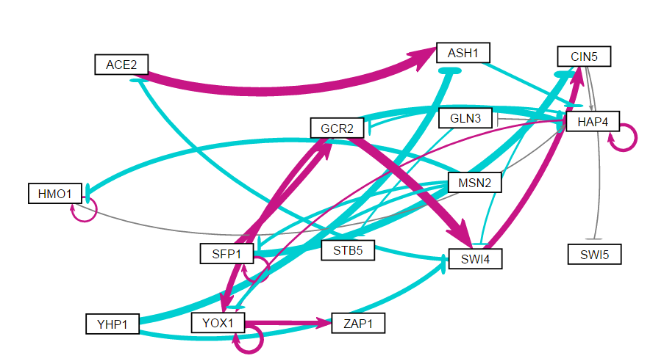
Random 11

Slide 25
Random 11
id | indegree | outdegree | degree | weighted indegree | weighted outdegree | weighted degree | eccentricity | closnesscentrality | harmonicclosnesscentrality | betweenesscentrality | modularity_class | pageranks | strongcompnum | clustering | eigencentrality
ACE2 | 1 | 1 | 2 | -1.53505 | 4.553833 | 3.018779 | 6 | 0.285714 | 0.361667 | 7 | 0 | 0.048539 | 5 | 0 | 0.153381
ASH1 | 2 | 1 | 3 | 0.932819 | -1.22015 | -0.28733 | 5 | 0.344828 | 0.42 | 15 | 0 | 0.070733 | 5 | 0 | 0.081086
CIN5 | 2 | 3 | 5 | -0.95583 | -0.38594 | -1.34176 | 3 | 0.5 | 0.6 | 19.5 | 1 | 0.059041 | 5 | 0 | 0.196252
GCR2 | 2 | 3 | 5 | 2.414428 | 4.192682 | 6.60711 | 3 | 0.5 | 0.6 | 23.5 | 1 | 0.068037 | 5 | 0.083333 | 0.412404
GLN3 | 1 | 1 | 2 | -0.03593 | -0.3321 | -0.36803 | 1 | 1 | 1 | 10 | 1 | 0.057535 | 3 | 0 | 0.369532
HAP4 | 5 | 4 | 9 | -3.21047 | 0.687322 | -2.52314 | 4 | 0.434783 | 0.566667 | 48 | 1 | 0.173328 | 5 | 0.190476 | 0.766884
HMO1 | 2 | 2 | 4 | -1.30446 | 0.552877 | -0.75158 | 5 | 0.323529 | 0.4 | 3 | 1 | 0.046196 | 6 | 0.333333 | 0.04721
MSN2 | 0 | 3 | 3 | 0 | -4.4787 | -4.4787 | 5 | 0.393939 | 0.515385 | 0 | 1 | 0.020698 | 8 | 0 | 0
SFP1 | 2 | 3 | 5 | -0.64287 | 0.405312 | -0.23756 | 4 | 0.407407 | 0.5 | 6 | 1 | 0.037062 | 7 | 0.25 | 0.04721
STB5 | 1 | 0 | 1 | -0.3321 | 0 | -0.3321 | 0 | 0 | 0 | 0 | 2 | 0.069622 | 2 | 0 | 0.165719
SWI4 | 3 | 2 | 5 | 2.082425 | 1.12064 | 3.203065 | 4 | 0.4 | 0.5 | 26 | 1 | 0.065502 | 5 | 0 | 0.308752
SWI5 | 1 | 0 | 1 | -0.0445 | 0 | -0.0445 | 0 | 0 | 0 | 0 | 3 | 0.037422 | 4 | 0 | 0.107721
YHP1 | 0 | 2 | 2 | 0 | -5.74957 | -5.74957 | 4 | 0.392857 | 0.484848 | 0 | 1 | 0.020698 | 9 | 0 | 0
YOX1 | 4 | 2 | 6 | 3.568879 | 3.491147 | 7.060026 | 1 | 1 | 1 | 10 | 1 | 0.143787 | 1 | 0.3 | 1
ZAP1 | 1 | 0 | 1 | 1.900009 | 0 | 1.900009 | 0 | 0 | 0 | 0 | 1 | 0.081801 | 0 | 0 | 0.429436

Slide 26
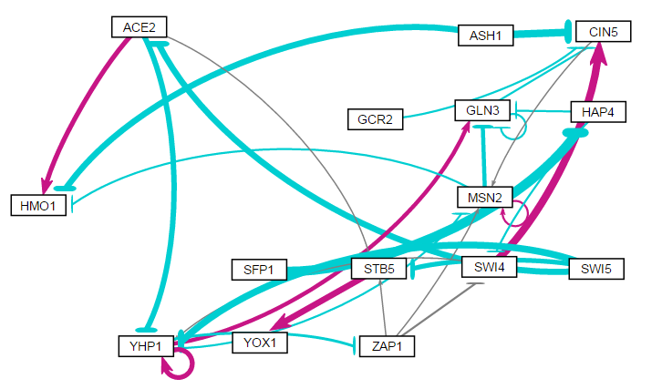
Random 12

Slide 27
Random 12
id | indegree | outdegree | degree | weighted indegree | weighted outdegree | weighted degree | eccentricity | closnesscentrality | harmonicclosnesscentrality | betweenesscentrality | modularity_class | pageranks | componentnumber | strongcompnum | clustering | eigencentrality
ACE2 | 1 | 3 | 4 | -3.16267 | -0.42753 | -3.5902 | 3 | 0.529412 | 0.62963 | 1 | 0 | 0.023531 | 0 | 5 | 0.166667 | 0.004447
ASH1 | 0 | 2 | 2 | 0 | -6.87493 | -6.87493 | 3 | 0.571429 | 0.708333 | 0 | 1 | 0.018336 | 0 | 6 | 0 | 0
CIN5 | 4 | 1 | 5 | -0.83278 | 0.092739 | -0.74004 | 2 | 0.6 | 0.666667 | 10.66667 | 2 | 0.13947 | 0 | 1 | 0.05 | 0.516323
GCR2 | 0 | 1 | 1 | 0 | -0.45186 | -0.45186 | 3 | 0.444444 | 0.541667 | 0 | 3 | 0.018336 | 0 | 7 | 0 | 0
GLN3 | 4 | 2 | 6 | -1.30478 | -1.08687 | -2.39164 | 3 | 0.5 | 0.611111 | 6.333333 | 4 | 0.188435 | 0 | 1 | 0.3 | 1
HAP4 | 1 | 2 | 3 | -5.22418 | -0.89182 | -6.116 | 5 | 0.36 | 0.485185 | 9 | 4 | 0.033923 | 0 | 8 | 0 | 0.004447
HMO1 | 3 | 0 | 3 | -0.9639 | 0 | -0.9639 | 0 | 0 | 0 | 0 | 0 | 0.095484 | 0 | 0 | 0 | 0.415695
MSN2 | 4 | 3 | 7 | 0.117362 | -1.68491 | -1.56755 | 2 | 0.75 | 0.833333 | 12 | 0 | 0.221352 | 0 | 1 | 0.266667 | 0.864647
SFP1 | 0 | 1 | 1 | 0 | -5.22418 | -5.22418 | 6 | 0.285714 | 0.373333 | 0 | 5 | 0.018336 | 0 | 9 | 0 | 0
STB5 | 3 | 1 | 4 | -2.24499 | 2.963337 | 0.718348 | 1 | 1 | 1 | 7 | 7 | 0.039079 | 0 | 3 | 0.083333 | 0.100787
SWI4 | 2 | 2 | 4 | -0.53266 | 4.096166 | 3.563508 | 4 | 0.444444 | 0.552083 | 13.66667 | 2 | 0.041637 | 0 | 4 | 0.083333 | 0.09634
SWI5 | 0 | 3 | 3 | 0 | -9.02412 | -9.02412 | 3 | 0.526316 | 0.616667 | 0 | 6 | 0.018336 | 0 | 10 | 0.333333 | 0
YHP1 | 4 | 4 | 8 | -4.24852 | 2.14897 | -2.09955 | 3 | 0.571429 | 0.666667 | 22.33333 | 4 | 0.060867 | 0 | 4 | 0.238095 | 0.223446
YOX1 | 1 | 0 | 1 | 2.963337 | 0 | 2.963337 | 0 | 0 | 0 | 0 | 7 | 0.051592 | 0 | 2 | 0 | 0.070514
ZAP1 | 1 | 3 | 4 | -1.00991 | -0.07868 | -1.08859 | 2 | 0.615385 | 0.6875 | 11 | 0 | 0.031287 | 0 | 4 | 0.166667 | 0.144038

Slide 28
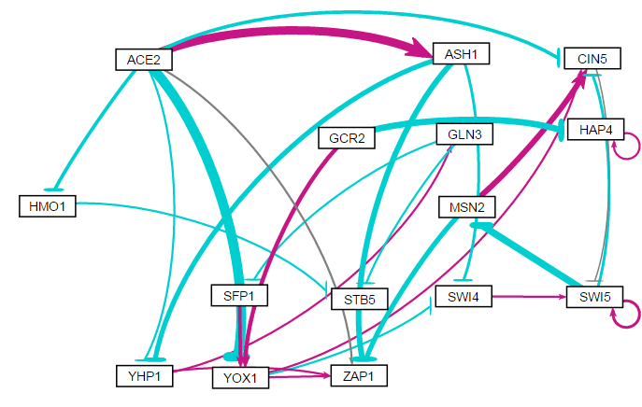
Random 13

Slide 29
Random 13
id | indegree | outdegree | degree | weighted indegree | weighted outdegree | weighted degree | eccentricity | closnesscentrality | harmonicclosnesscentrality | betweenesscentrality | modularity_class | pageranks | componentnumber | strongcompnum | clustering | eigencentrality
ACE2 | 0 | 6 | 6 | 0 | -4.57617 | -4.57617 | 3 | 0.6 | 0.722222 | 0 | 0 | 0.017579 | 0 | 10 | 0.166667 | 0
ASH1 | 1 | 3 | 4 | 5.123611 | -6.39891 | -1.2753 | 4 | 0.434783 | 0.558333 | 0.5 | 0 | 0.020069 | 0 | 9 | 0.25 | 0.005094
CIN5 | 4 | 1 | 5 | 0.63547 | -0.00105 | 0.634422 | 3 | 0.5 | 0.611111 | 8 | 3 | 0.135782 | 0 | 1 | 0.166667 | 0.812552
GCR2 | 0 | 2 | 2 | 0 | -1.33196 | -1.33196 | 4 | 0.466667 | 0.583333 | 0 | 5 | 0.017579 | 0 | 12 | 0 | 0
GLN3 | 1 | 2 | 3 | 0.405229 | -0.97099 | -0.56576 | 5 | 0.363636 | 0.49375 | 11 | 5 | 0.028526 | 0 | 6 | 0 | 0.036297
HAP4 | 2 | 1 | 3 | -2.87073 | 0.666019 | -2.20471 | 0 | 0 | 0 | 0 | 1 | 0.1662 | 0 | 11 | 0.5 | 0.074161
HMO1 | 1 | 1 | 2 | -1.39662 | -0.31537 | -1.71199 | 1 | 1 | 1 | 1 | 2 | 0.020069 | 0 | 8 | 0 | 0.005094
MSN2 | 1 | 2 | 3 | -4.00846 | 0.259081 | -3.74938 | 2 | 0.75 | 0.833333 | 3 | 3 | 0.083035 | 0 | 1 | 0.333333 | 0.505554
SFP1 | 1 | 1 | 2 | -0.58021 | 1.762936 | 1.182729 | 4 | 0.428571 | 0.513889 | 12 | 5 | 0.029703 | 0 | 5 | 0 | 0.042811
STB5 | 2 | 0 | 2 | -0.70616 | 0 | -0.70616 | 0 | 0 | 0 | 0 | 4 | 0.046763 | 0 | 4 | 0 | 0.058338
SWI4 | 2 | 1 | 3 | -1.2936 | 0.428735 | -0.86487 | 3 | 0.5 | 0.583333 | 8 | 5 | 0.038224 | 0 | 2 | 0 | 0.076126
SWI5 | 3 | 3 | 6 | 1.723793 | -3.94005 | -2.21626 | 2 | 0.75 | 0.833333 | 13 | 5 | 0.230968 | 0 | 1 | 0.416667 | 1
YHP1 | 2 | 2 | 4 | -3.08242 | 0.759837 | -2.32258 | 6 | 0.321429 | 0.466667 | 6 | 5 | 0.025756 | 0 | 7 | 0.25 | 0.020621
YOX1 | 3 | 3 | 6 | -2.33687 | 0.474592 | -1.86228 | 3 | 0.625 | 0.766667 | 19.5 | 5 | 0.05279 | 0 | 3 | 0.066667 | 0.052348
ZAP1 | 5 | 0 | 5 | -4.79632 | 0 | -4.79632 | 0 | 0 | 0 | 0 | 5 | 0.086959 | 0 | 0 | 0.2 | 0.358822

Slide 30
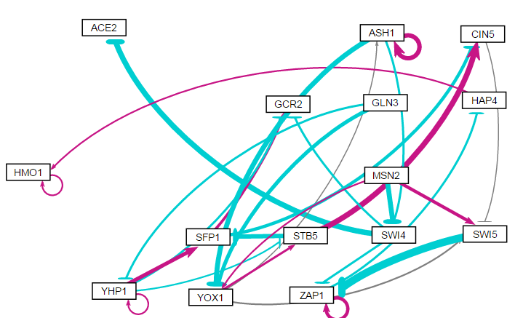
Random 14

Slide 31
Random 14
id | indegree | outdegree | degree | weighted indegree | weighted outdegree | weighted degree | eccentricity | closnesscentrality | harmonicclosnesscentrality | betweenesscentrality | modularity_class | pageranks | componentnumber | strongcompnum | clustering | eigencentrality
ACE2 | 1 | 0 | 1 | -2.21408 | 0 | -2.21408 | 0 | 0 | 0 | 0 | 0 | 0.020741 | 0 | 0 | 0 | 0.17123
ASH1 | 2 | 3 | 5 | 1.498397 | -0.89638 | 0.602021 | 4 | 0.44 | 0.522727 | 4.5 | 4 | 0.031194 | 0 | 10 | 0.5 | 0.457828
CIN5 | 2 | 1 | 3 | 1.022009 | -0.00267 | 1.019342 | 4 | 0.4 | 0.520833 | 12 | 4 | 0.037901 | 0 | 6 | 0.166667 | 0.390323
GCR2 | 3 | 0 | 3 | -0.12256 | 0 | -0.12256 | 0 | 0 | 0 | 0 | 3 | 0.038725 | 0 | 5 | 0.166667 | 0.458507
GLN3 | 0 | 2 | 2 | 0 | -1.8815 | -1.8815 | 5 | 0.382353 | 0.476923 | 0 | 1 | 0.013371 | 0 | 12 | 0 | 0
HAP4 | 1 | 1 | 2 | -0.47181 | 0.228268 | -0.24354 | 1 | 1 | 1 | 11 | 2 | 0.065517 | 0 | 2 | 0 | 0.550101
HMO1 | 2 | 1 | 3 | 0.571175 | 0.342907 | 0.914082 | 0 | 0 | 0 | 0 | 2 | 0.458696 | 0 | 1 | 0.5 | 0.573921
MSN2 | 0 | 3 | 3 | 0 | -0.41735 | -0.41735 | 4 | 0.461538 | 0.5625 | 0 | 4 | 0.013371 | 0 | 13 | 0.166667 | 0
SFP1 | 2 | 2 | 4 | -0.25541 | -0.33553 | -0.59094 | 5 | 0.375 | 0.547222 | 4.333333 | 3 | 0.030204 | 0 | 7 | 0.25 | 0.280491
STB5 | 2 | 2 | 4 | 0.189986 | 0.558325 | 0.748311 | 5 | 0.388889 | 0.540476 | 9.666667 | 4 | 0.027495 | 0 | 8 | 0.166667 | 0.272275
SWI4 | 2 | 3 | 5 | -2.4937 | -3.15488 | -5.64858 | 3 | 0.625 | 0.766667 | 11 | 5 | 0.026002 | 0 | 9 | 0 | 0.279776
SWI5 | 3 | 1 | 4 | 1.275982 | -3.14215 | -1.86617 | 3 | 0.5 | 0.611111 | 19.5 | 4 | 0.058371 | 0 | 4 | 0.083333 | 0.440953
YHP1 | 2 | 4 | 6 | -0.26704 | 0.894902 | 0.627859 | 6 | 0.347826 | 0.55625 | 3.166667 | 3 | 0.024198 | 0 | 11 | 0.3 | 0.094223
YOX1 | 3 | 3 | 6 | -2.81796 | 0.596177 | -2.22178 | 4 | 0.458333 | 0.568182 | 15.83333 | 4 | 0.031686 | 0 | 10 | 0.05 | 0.285277
ZAP1 | 3 | 2 | 5 | -2.42496 | 0.699917 | -1.72504 | 2 | 0.666667 | 0.75 | 20 | 5 | 0.122528 | 0 | 3 | 0.25 | 1

Slide 32
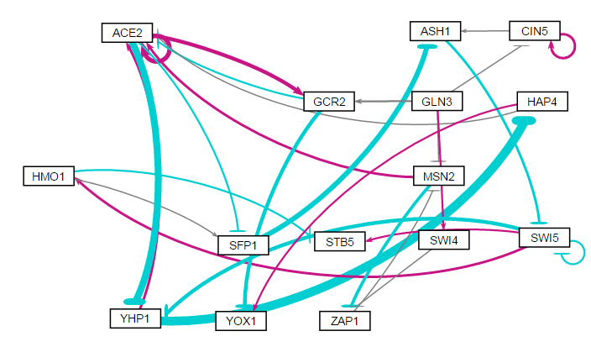
Random 15

Slide 33
Random 15
id | indegree | outdegree | degree | weighted indegree | weighted outdegree | weighted degree | eccentricity | closnesscentrality | harmonicclosnesscentrality | betweenesscentrality | modularity_class | pageranks | componentnumber | strongcompnum | clustering | eigencentrality
ACE2 | 5 | 4 | 9 | 4.564979 | -0.62894 | 3.936037 | 4 | 0.45 | 0.592593 | 55 | 0 | 0.160498 | 0 | 2 | 0.266667 | 1
ASH1 | 2 | 1 | 3 | -3.7454 | -1.25451 | -4.9999 | 4 | 0.375 | 0.444444 | 47 | 1 | 0.090499 | 0 | 2 | 0 | 0.254142
CIN5 | 2 | 2 | 4 | 1.248502 | 1.494663 | 2.743165 | 5 | 0.294118 | 0.365 | 4 | 1 | 0.035539 | 0 | 3 | 0.333333 | 0.047193
GCR2 | 2 | 2 | 4 | 2.77304 | -2.96317 | -0.19013 | 5 | 0.346154 | 0.47963 | 7 | 0 | 0.054571 | 0 | 2 | 0 | 0.434017
GLN3 | 0 | 4 | 4 | 0 | 0.370977 | 0.370977 | 4 | 0.424242 | 0.553571 | 0 | 2 | 0.016859 | 0 | 6 | 0 | 0
HAP4 | 1 | 2 | 3 | -7.24766 | 0.1629 | -7.08476 | 5 | 0.36 | 0.498148 | 6 | 3 | 0.049274 | 0 | 2 | 0.333333 | 0.236288
HMO1 | 1 | 2 | 3 | 1.302668 | -0.34055 | 0.962114 | 6 | 0.272727 | 0.424074 | 4 | 4 | 0.042151 | 0 | 2 | 0.166667 | 0.119885
MSN2 | 2 | 2 | 4 | -0.53552 | -0.93925 | -1.47477 | 5 | 0.354839 | 0.468182 | 22.5 | 0 | 0.077622 | 0 | 4 | 0 | 0.055046
SFP1 | 2 | 1 | 3 | -0.55506 | -3.86022 | -4.41528 | 5 | 0.3 | 0.377778 | 36 | 0 | 0.0689 | 0 | 2 | 0 | 0.491526
STB5 | 2 | 0 | 2 | 0.472988 | 0 | 0.472988 | 0 | 0 | 0 | 0 | 4 | 0.060061 | 0 | 1 | 0.5 | 0.181691
SWI4 | 1 | 1 | 2 | 0.406762 | -0.11981 | 0.286948 | 7 | 0.226415 | 0.302976 | 0.5 | 2 | 0.020441 | 0 | 5 | 0 | 0.004297
SWI5 | 2 | 4 | 6 | -1.93257 | -1.05718 | -2.98976 | 3 | 0.5 | 0.611111 | 44 | 4 | 0.119118 | 0 | 2 | 0.25 | 0.242533
YHP1 | 2 | 2 | 4 | -7.90923 | -5.73255 | -13.6418 | 5 | 0.36 | 0.498148 | 26 | 0 | 0.076282 | 0 | 2 | 0.166667 | 0.549604
YOX1 | 2 | 0 | 2 | -2.01194 | 0 | -2.01194 | 0 | 0 | 0 | 0 | 3 | 0.060992 | 0 | 0 | 0 | 0.287179
ZAP1 | 2 | 1 | 3 | -1.99237 | -0.29315 | -2.28552 | 6 | 0.268293 | 0.343939 | 11 | 5 | 0.067191 | 0 | 4 | 0 | 0.058639

Slide 34
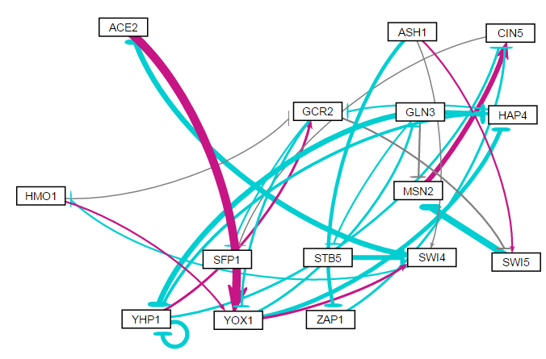
Random 16

Slide 35
Random 16
id | indegree | outdegree | degree | weighted indegree | weighted outdegree | weighted degree | eccentricity | closnesscentrality | harmonicclosnesscentrality | betweenesscentrality | modularity_class | pageranks | componentnumber | strongcompnum | clustering | eigencentrality
ACE2 | 1 | 1 | 2 | -3.13349 | 5.258309 | 2.124824 | 4 | 0.352941 | 0.409722 | 8.52381 | 0 | 0.051089 | 0 | 4 | 0.5 | 0.274557
ASH1 | 0 | 3 | 3 | 0 | -1.30218 | -1.30218 | 5 | 0.368421 | 0.492857 | 0 | 2 | 0.018051 | 0 | 6 | 0 | 0
CIN5 | 3 | 1 | 4 | 0.921709 | -0.01752 | 0.904194 | 1 | 1 | 1 | 5 | 1 | 0.117223 | 0 | 1 | 0 | 0.737231
GCR2 | 3 | 3 | 6 | 0.530769 | -1.66279 | -1.13202 | 3 | 0.461538 | 0.555556 | 32.70238 | 2 | 0.085848 | 0 | 4 | 0.1 | 0.948246
GLN3 | 1 | 4 | 5 | -0.85583 | -7.00631 | -7.86214 | 3 | 0.48 | 0.597222 | 18.30952 | 1 | 0.048499 | 0 | 4 | 0.1 | 0.399598
HAP4 | 2 | 2 | 4 | -5.33979 | -1.9337 | -7.2735 | 4 | 0.387097 | 0.479167 | 12.7381 | 1 | 0.058808 | 0 | 4 | 0.333333 | 0.603232
HMO1 | 1 | 2 | 3 | -0.51459 | 0.267305 | -0.24729 | 4 | 0.428571 | 0.506944 | 16.47619 | 0 | 0.051089 | 0 | 4 | 0.333333 | 0.274557
MSN2 | 2 | 1 | 3 | -3.98966 | 2.456613 | -1.53305 | 2 | 0.666667 | 0.75 | 5.77381 | 1 | 0.068724 | 0 | 2 | 0 | 0.446266
SFP1 | 2 | 0 | 2 | -0.3649 | 0 | -0.3649 | 0 | 0 | 0 | 0 | 1 | 0.142021 | 0 | 0 | 0 | 0.851918
STB5 | 1 | 1 | 2 | -0.40986 | -2.70767 | -3.11754 | 6 | 0.27907 | 0.352778 | 3 | 1 | 0.02836 | 0 | 4 | 0 | 0.203634
SWI4 | 3 | 2 | 5 | -1.64435 | -3.64808 | -5.29242 | 5 | 0.342857 | 0.440278 | 31 | 1 | 0.077703 | 0 | 4 | 0.1 | 0.511657
SWI5 | 2 | 1 | 3 | 0.074277 | -3.74178 | -3.66751 | 3 | 0.5 | 0.611111 | 6.702381 | 2 | 0.047479 | 0 | 3 | 0 | 0.477128
YHP1 | 3 | 3 | 6 | -6.66066 | -1.67915 | -8.33982 | 4 | 0.375 | 0.465278 | 6.47619 | 2 | 0.074448 | 0 | 4 | 0.3 | 1
YOX1 | 3 | 3 | 6 | 4.476457 | -2.08885 | 2.387603 | 3 | 0.5 | 0.583333 | 50.29762 | 0 | 0.107496 | 0 | 4 | 0.166667 | 0.775984
ZAP1 | 1 | 1 | 2 | -1.72267 | -0.82678 | -2.54946 | 2 | 0.666667 | 0.75 | 2 | 1 | 0.023162 | 0 | 5 | 0 | 0.004905

Slide 36
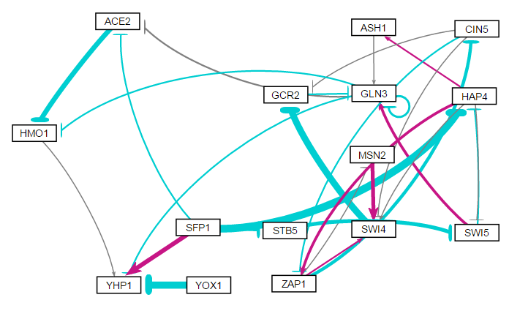
Random 17

Slide 37
Random 17
id | indegree | outdegree | degree | eccentricity | closnesscentrality | harmonicclosnesscentrality | betweenesscentrality | weighted indegree | weighted outdegree | weighted degree | modularity_class | pageranks | componentnumber | strongcompnum | clustering | eigencentrality
ACE2 | 2 | 1 | 3 | 2 | 0.666667 | 0.75 | 1 | -0.89019 | -3.24068 | -4.13087 | 0 | 0.06375 | 0 | 2 | 0.166667 | 0.555013
ASH1 | 1 | 1 | 2 | 2 | 0.571429 | 0.625 | 2.333333 | 0.537158 | 0.178975 | 0.716133 | 3 | 0.029759 | 0 | 4 | 0 | 0.090588
CIN5 | 1 | 3 | 4 | 3 | 0.5 | 0.625 | 2.5 | -1.75811 | -0.57464 | -2.33275 | 4 | 0.030961 | 0 | 8 | 0.333333 | 0.134357
GCR2 | 2 | 1 | 3 | 2 | 0.571429 | 0.625 | 16 | -4.60974 | -0.27255 | -4.88229 | 1 | 0.0932 | 0 | 5 | 0.166667 | 0.376571
GLN3 | 4 | 4 | 8 | 1 | 1 | 1 | 27 | 0.580429 | -1.96769 | -1.38726 | 2 | 0.185455 | 0 | 3 | 0.190476 | 0.958518
HAP4 | 2 | 4 | 6 | 3 | 0.52381 | 0.636364 | 19.16667 | -5.97922 | 1.72124 | -4.25798 | 3 | 0.045712 | 0 | 9 | 0.05 | 0.102957
HMO1 | 2 | 1 | 3 | 1 | 1 | 1 | 1 | -3.6418 | 0.238098 | -3.40371 | 5 | 0.113707 | 0 | 1 | 0.333333 | 0.84934
MSN2 | 1 | 1 | 2 | 4 | 0.333333 | 0.430556 | 0 | -0.21334 | 2.200719 | 1.987377 | 4 | 0.030961 | 0 | 7 | 0.5 | 0.134357
SFP1 | 0 | 4 | 4 | 3 | 0.5 | 0.602564 | 0 | 0 | -5.23367 | -5.23367 | 5 | 0.020047 | 0 | 11 | 0 | 0
STB5 | 1 | 1 | 2 | 4 | 0.342857 | 0.395833 | 0.833333 | -1.86774 | -2.15159 | -4.01933 | 6 | 0.024303 | 0 | 10 | 0 | 0.005531
SWI4 | 4 | 1 | 5 | 3 | 0.416667 | 0.5 | 11.5 | 2.515488 | -4.59207 | -2.07658 | 4 | 0.075749 | 0 | 6 | 0.25 | 0.41191
SWI5 | 2 | 2 | 4 | 3 | 0.478261 | 0.545455 | 13.66667 | -2.23414 | 0.844851 | -1.38929 | 2 | 0.050397 | 0 | 9 | 0 | 0.107883
YHP1 | 4 | 0 | 4 | 0 | 0 | 0 | 0 | -2.69329 | 0 | -2.69329 | 5 | 0.177426 | 0 | 0 | 0.083333 | 1
YOX1 | 0 | 1 | 1 | 1 | 1 | 1 | 0 | 0 | -5.03915 | -5.03915 | 7 | 0.020047 | 0 | 12 | 0 | 0
ZAP1 | 2 | 3 | 5 | 4 | 0.4 | 0.572917 | 9 | 0.674435 | -1.69191 | -1.01748 | 3 | 0.038528 | 0 | 8 | 0.25 | 0.184071

Slide 38
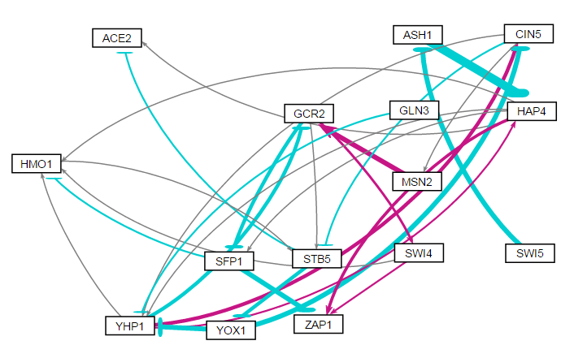
Random 18

Slide 39
Random 18
id | indegree | outdegree | degree | weighted indegree | weighted outdegree | weighted degree | eccentricity | closnesscentrality | harmonicclosnesscentrality | betweenesscentrality | modularity_class | pageranks | componentnumber | strongcompnum | clustering | eigencentrality
ACE2 | 2 | 0 | 2 | -0.35455 | 0 | -0.35455 | 0 | 0 | 0 | 0 | 2 | 0.090577 | 0 | 0 | 0 | 0.686984
ASH1 | 1 | 1 | 2 | -4.39611 | -8.19634 | -12.5925 | 4 | 0.375 | 0.4375 | 12 | 0 | 0.035402 | 0 | 3 | 0 | 0.004927
CIN5 | 2 | 3 | 5 | -1.81197 | -0.03008 | -1.84205 | 3 | 0.5 | 0.590909 | 13.83333 | 2 | 0.074146 | 0 | 2 | 0.166667 | 0.586155
GCR2 | 2 | 3 | 5 | 1.460765 | -0.83622 | 0.624544 | 4 | 0.44 | 0.560606 | 25 | 3 | 0.074898 | 0 | 2 | 0 | 0.49629
GLN3 | 0 | 1 | 1 | 0 | -0.64703 | -0.64703 | 4 | 0.387097 | 0.4375 | 0 | 1 | 0.019131 | 0 | 4 | 0 | 0
HAP4 | 2 | 5 | 7 | -7.2717 | 3.07866 | -4.19303 | 3 | 0.55 | 0.681818 | 33.83333 | 2 | 0.070872 | 0 | 2 | 0.1 | 0.3729
HMO1 | 4 | 1 | 5 | 0.117715 | 0.345624 | 0.463338 | 5 | 0.289474 | 0.365152 | 25.33333 | 3 | 0.092227 | 0 | 2 | 0.15 | 0.917836
MSN2 | 1 | 1 | 2 | 0.180897 | 4.121982 | 4.302879 | 5 | 0.34375 | 0.412121 | 1.333333 | 3 | 0.040155 | 0 | 2 | 0 | 0.283202
SFP1 | 2 | 2 | 4 | -2.65033 | -4.38944 | -7.03977 | 6 | 0.282051 | 0.40303 | 2 | 4 | 0.052399 | 0 | 2 | 0.166667 | 0.448848
STB5 | 3 | 2 | 5 | 0.127573 | -3.15378 | -3.02621 | 4 | 0.366667 | 0.462121 | 44.5 | 3 | 0.139761 | 0 | 2 | 0.05 | 1
SWI4 | 1 | 2 | 3 | 1.729261 | 0.829781 | 2.559042 | 6 | 0.282051 | 0.40303 | 2 | 3 | 0.04035 | 0 | 2 | 0 | 0.24881
SWI5 | 0 | 1 | 1 | 0 | -4.39611 | -4.39611 | 5 | 0.288889 | 0.347436 | 0 | 5 | 0.019131 | 0 | 5 | 0 | 0
YHP1 | 4 | 4 | 8 | -4.29426 | 1.138007 | -3.15625 | 3 | 0.578947 | 0.666667 | 53.16667 | 2 | 0.101843 | 0 | 2 | 0.066667 | 0.716537
YOX1 | 1 | 2 | 3 | -2.61798 | -8.43421 | -11.0522 | 3 | 0.458333 | 0.530303 | 36 | 6 | 0.078528 | 0 | 2 | 0.5 | 0.486946
ZAP1 | 3 | 0 | 3 | -0.78847 | 0 | -0.78847 | 0 | 0 | 0 | 0 | 2 | 0.07058 | 0 | 1 | 0.166667 | 0.560051

Slide 40
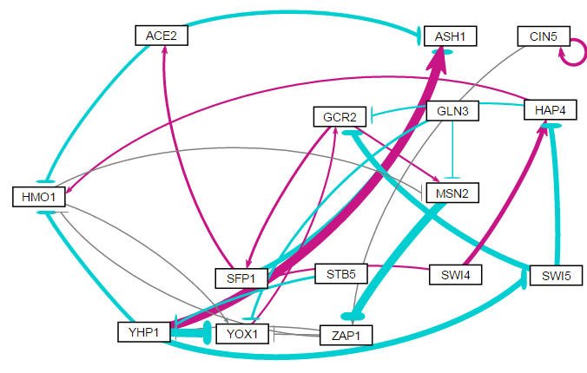
Random 19

Slide 41
Random 19
id | indegree | outdegree | degree | weighted indegree | weighted outdegree | weighted degree | eccentricity | closnesscentrality | harmonicclosnesscentrality | betweenesscentrality | modularity_class | pageranks | componentnumber | strongcompnum | clustering | eigencentrality
ACE2 | 1 | 2 | 3 | 0.802285 | -2.78834 | -1.98606 | 6 | 0.322581 | 0.453333 | 9 | 1 | 0.048183 | 0 | 1 | 0.166667 | 0.271832
ASH1 | 3 | 0 | 3 | 0.923141 | 0 | 0.923141 | 0 | 0 | 0 | 0 | 4 | 0.082122 | 0 | 0 | 0.166667 | 0.627181
CIN5 | 1 | 2 | 3 | 1.439009 | 1.574092 | 3.013101 | 5 | 0.34375 | 0.412121 | 0 | 3 | 0.025481 | 0 | 2 | 0.5 | 0.051393
GCR2 | 3 | 2 | 5 | -3.28036 | 1.748269 | -1.53209 | 5 | 0.384615 | 0.495 | 38 | 1 | 0.136328 | 0 | 1 | 0.05 | 0.789693
GLN3 | 0 | 2 | 2 | 0 | -1.15496 | -1.15496 | 5 | 0.34375 | 0.45 | 0 | 0 | 0.01465 | 0 | 3 | 0 | 0
HAP4 | 2 | 2 | 4 | -0.37936 | -0.26497 | -0.64433 | 5 | 0.384615 | 0.495 | 9 | 3 | 0.032828 | 0 | 1 | 0.083333 | 0.127134
HMO1 | 4 | 2 | 6 | -2.71453 | -0.02906 | -2.74358 | 5 | 0.344828 | 0.461667 | 28 | 3 | 0.098882 | 0 | 1 | 0.133333 | 0.783217
MSN2 | 3 | 1 | 4 | 0.2569 | -4.20667 | -3.94977 | 5 | 0.344828 | 0.42 | 38 | 1 | 0.120862 | 0 | 1 | 0.083333 | 0.930445
SFP1 | 2 | 2 | 4 | 1.464592 | -1.51135 | -0.04676 | 7 | 0.277778 | 0.417619 | 19 | 1 | 0.078849 | 0 | 1 | 0.083333 | 0.467841
STB5 | 0 | 1 | 1 | 0 | -1.0671 | -1.0671 | 5 | 0.354839 | 0.427273 | 0 | 2 | 0.01465 | 0 | 4 | 0 | 0
SWI4 | 0 | 2 | 2 | 0 | 2.431658 | 2.431658 | 6 | 0.354839 | 0.480303 | 0 | 3 | 0.01465 | 0 | 5 | 0 | 0
SWI5 | 1 | 2 | 3 | -2.82837 | -5.43301 | -8.26138 | 4 | 0.416667 | 0.508333 | 14 | 1 | 0.028128 | 0 | 1 | 0.166667 | 0.19838
YHP1 | 2 | 4 | 6 | -1.16642 | -4.13724 | -5.30366 | 4 | 0.5 | 0.641667 | 34 | 4 | 0.063438 | 0 | 1 | 0.1 | 0.339015
YOX1 | 4 | 1 | 5 | -5.32776 | 0.378939 | -4.94882 | 6 | 0.30303 | 0.386667 | 22 | 1 | 0.112702 | 0 | 1 | 0.15 | 1
ZAP1 | 2 | 3 | 5 | -4.07159 | -0.42271 | -4.4943 | 4 | 0.47619 | 0.591667 | 46 | 3 | 0.128247 | 0 | 1 | 0.2 | 0.582891

Slide 42
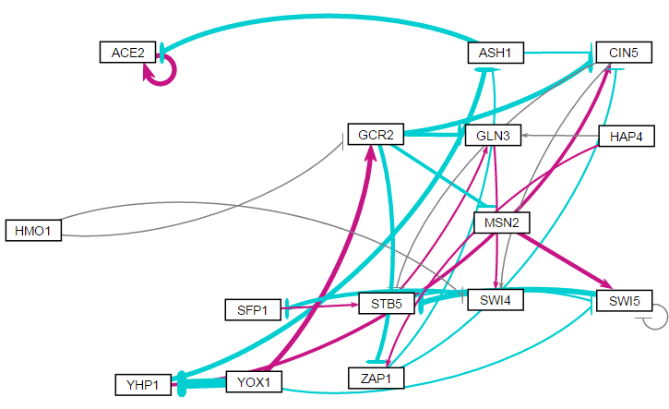
Random 20

Slide 43
Random 20
id | indegree | outdegree | degree | weighted indegree | weighted outdegree | weighted degree | eccentricity | closnesscentrality | harmonicclosnesscentrality | betweenesscentrality | modularity_class | pageranks | componentnumber | strongcompnum | clustering | eigencentrality
ACE2 | 2 | 1 | 3 | 0.358296 | 2.8979 | 3.256196 | 0 | 0 | 0 | 0 | 0 | 0.131984 | 0 | 0 | 0.5 | 0.227724
ASH1 | 2 | 2 | 4 | -3.19593 | -3.15127 | -6.3472 | 3 | 0.466667 | 0.571429 | 6 | 3 | 0.023053 | 0 | 3 | 0.166667 | 0.062776
CIN5 | 4 | 2 | 6 | -2.22481 | -0.032 | -2.25681 | 2 | 0.625 | 0.7 | 20.83333 | 2 | 0.036481 | 0 | 2 | 0.1 | 0.159954
GCR2 | 2 | 4 | 6 | 2.481132 | -9.04349 | -6.56236 | 3 | 0.555556 | 0.666667 | 12.33333 | 1 | 0.017083 | 0 | 6 | 0.033333 | 0.010219
GLN3 | 3 | 1 | 4 | -1.45641 | 0.530964 | -0.92545 | 4 | 0.4 | 0.520833 | 10.66667 | 2 | 0.102433 | 0 | 1 | 0 | 0.478631
HAP4 | 0 | 2 | 2 | 0 | 0.757682 | 0.757682 | 4 | 0.428571 | 0.527778 | 0 | 3 | 0.01 | 0 | 7 | 0 | 0
HMO1 | 0 | 2 | 2 | 0 | -0.26904 | -0.26904 | 4 | 0.44 | 0.522727 | 0 | 4 | 0.01 | 0 | 8 | 0 | 0
MSN2 | 1 | 1 | 2 | -1.85596 | 2.136853 | 0.280897 | 5 | 0.333333 | 0.456667 | 2 | 5 | 0.01363 | 0 | 5 | 0 | 0.026186
SFP1 | 1 | 1 | 2 | -2.04884 | 0.491424 | -1.55742 | 3 | 0.5 | 0.583333 | 5.5 | 6 | 0.10926 | 0 | 1 | 0 | 0.272052
STB5 | 3 | 2 | 5 | -2.8542 | -0.11333 | -2.96753 | 3 | 0.571429 | 0.708333 | 21 | 2 | 0.198956 | 0 | 1 | 0 | 0.828079
SWI4 | 3 | 1 | 4 | 0.43429 | -2.04884 | -1.61455 | 3 | 0.444444 | 0.541667 | 14.5 | 2 | 0.116873 | 0 | 1 | 0 | 0.431256
SWI5 | 4 | 2 | 6 | 0.98593 | -3.30683 | -2.3209 | 4 | 0.4 | 0.520833 | 5 | 5 | 0.189532 | 0 | 1 | 0.333333 | 1
YHP1 | 1 | 2 | 3 | -6.64616 | -1.13691 | -7.78308 | 3 | 0.470588 | 0.5625 | 3.166667 | 2 | 0.012833 | 0 | 9 | 0.166667 | 0.00511
YOX1 | 0 | 3 | 3 | 0 | -4.54874 | -4.54874 | 4 | 0.48 | 0.576389 | 0 | 1 | 0.01 | 0 | 10 | 0 | 0
ZAP1 | 2 | 2 | 4 | -1.68036 | -0.86738 | -2.54773 | 3 | 0.470588 | 0.5625 | 9 | 3 | 0.01788 | 0 | 4 | 0.166667 | 0.031296

Slide 44
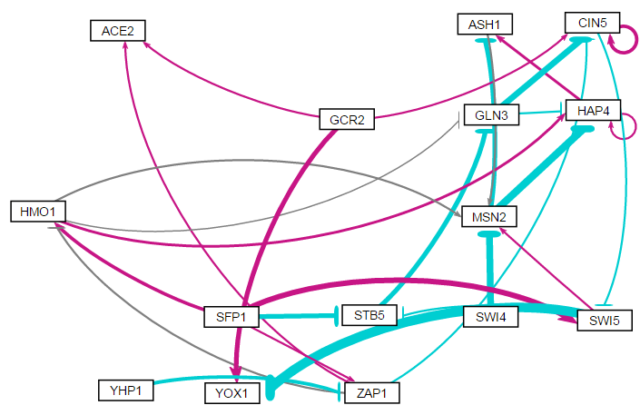
Random 21

Slide 45
Random 21
id | indegree | outdegree | degree | weighted indegree | weighted outdegree | weighted degree | eccentricity | closnesscentrality | harmonicclosnesscentrality | betweenesscentrality | pageranks | modularity_class | componentnumber | strongcompnum | clustering | eigencentrality
ACE2 | 2 | 0 | 2 | 1.193761 | 0 | 1.193761 | 0 | 0 | 0 | 0 | 0.024515 | 0 | 0 | 0 | 0 | 0.030724
ASH1 | 2 | 1 | 3 | -1.36303 | 0.262875 | -1.10015 | 2 | 0.666667 | 0.75 | 2 | 0.200862 | 1 | 0 | 1 | 0.5 | 0.84703
CIN5 | 4 | 2 | 6 | -1.41075 | 0.909888 | -0.50087 | 3 | 0.4375 | 0.5 | 21 | 0.076039 | 0 | 0 | 3 | 0.2 | 0.399302
GCR2 | 0 | 3 | 3 | 0 | 2.985829 | 2.985829 | 4 | 0.391304 | 0.546296 | 0 | 0.013123 | 0 | 0 | 4 | 0 | 0
GLN3 | 2 | 2 | 4 | -2.24796 | -3.30556 | -5.55352 | 3 | 0.466667 | 0.571429 | 11 | 0.045015 | 1 | 0 | 3 | 0.083333 | 0.148883
HAP4 | 4 | 2 | 6 | -2.71316 | 1.301842 | -1.41132 | 2 | 0.666667 | 0.75 | 4.833333 | 0.226703 | 1 | 0 | 1 | 0.4 | 1
HMO1 | 2 | 3 | 5 | 1.269363 | 1.094265 | 2.363629 | 4 | 0.444444 | 0.604167 | 10.66667 | 0.023585 | 4 | 0 | 5 | 0.15 | 0.030724
MSN2 | 4 | 2 | 6 | -2.60313 | -5.88333 | -8.48647 | 1 | 1 | 1 | 11.16667 | 0.215278 | 4 | 0 | 1 | 0.1 | 0.622101
SFP1 | 0 | 4 | 4 | 0 | 2.254024 | 2.254024 | 3 | 0.578947 | 0.666667 | 0 | 0.013123 | 4 | 0 | 7 | 0.166667 | 0
STB5 | 2 | 1 | 3 | -2.73862 | -2.24063 | -4.97925 | 4 | 0.368421 | 0.452381 | 4.5 | 0.029615 | 2 | 0 | 3 | 0.166667 | 0.167101
SWI4 | 0 | 1 | 1 | 0 | -3.68103 | -3.68103 | 2 | 0.6 | 0.666667 | 0 | 0.013123 | 3 | 0 | 8 | 0 | 0
SWI5 | 2 | 3 | 5 | 1.888958 | -5.1865 | -3.29754 | 3 | 0.583333 | 0.690476 | 22.83333 | 0.048281 | 4 | 0 | 3 | 0.05 | 0.265461
YHP1 | 0 | 1 | 1 | 0 | -1.2043 | -1.2043 | 4 | 0.354839 | 0.416667 | 0 | 0.013123 | 5 | 0 | 9 | 0 | 0
YOX1 | 2 | 0 | 2 | -3.26408 | 0 | -3.26408 | 0 | 0 | 0 | 0 | 0.030545 | 0 | 0 | 2 | 0 | 0.167101
ZAP1 | 2 | 3 | 5 | -0.64697 | 0.057011 | -0.58996 | 3 | 0.5 | 0.6 | 12 | 0.02707 | 0 | 0 | 6 | 0.05 | 0.010406

Slide 46
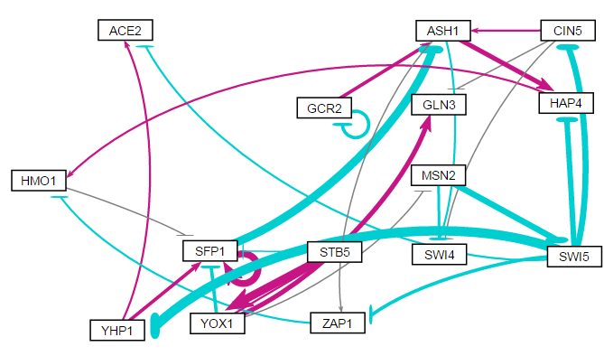
Random 22

Slide 47
Random 22
id | indegree | outdegree | degree | weighted indegree | weighted outdegree | weighted degree | eccentricity | closnesscentrality | harmonicclosnesscentrality | betweenesscentrality | modularity_class | pageranks | componentnumber | strongcompnum | clustering | eigencentrality
ACE2 | 2 | 0 | 2 | 0.216374 | 0 | 0.216374 | 0 | 0 | 0 | 0 | 6 | 0.032374 | 0 | 0 | 0.5 | 0.090657
ASH1 | 3 | 3 | 6 | -2.47934 | 1.552262 | -0.92708 | 3 | 0.625 | 0.766667 | 29 | 2 | 0.151223 | 0 | 2 | 0.033333 | 0.670965
CIN5 | 1 | 3 | 4 | -2.64331 | 0.134885 | -2.50843 | 4 | 0.5 | 0.654762 | 5 | 2 | 0.022719 | 0 | 4 | 0.083333 | 0.045328
GCR2 | 1 | 2 | 3 | -1.28778 | -0.17615 | -1.46394 | 4 | 0.428571 | 0.513889 | 0 | 2 | 0.031204 | 0 | 5 | 0.5 | 0.045328
GLN3 | 2 | 0 | 2 | 1.875992 | 0 | 1.875992 | 0 | 0 | 0 | 0 | 1 | 0.03035 | 0 | 3 | 0 | 0.090657
HAP4 | 2 | 1 | 3 | -0.36396 | 0.301132 | -0.06283 | 4 | 0.357143 | 0.466667 | 6 | 2 | 0.065591 | 0 | 2 | 0 | 0.438105
HMO1 | 2 | 1 | 3 | -0.11713 | -0.11227 | -0.22939 | 3 | 0.416667 | 0.5 | 11 | 2 | 0.129472 | 0 | 2 | 0 | 0.51129
MSN2 | 1 | 2 | 3 | -0.15755 | -3.17235 | -3.3299 | 3 | 0.458333 | 0.530303 | 11 | 3 | 0.023914 | 0 | 8 | 0 | 0.045328
SFP1 | 5 | 2 | 7 | 2.808774 | -0.66167 | 2.147109 | 3 | 0.5 | 0.566667 | 22 | 6 | 0.267306 | 0 | 2 | 0.233333 | 1
STB5 | 1 | 2 | 3 | 0.41911 | 3.377531 | 3.79664 | 4 | 0.361111 | 0.448718 | 0 | 1 | 0.023914 | 0 | 9 | 0.5 | 0.045328
SWI4 | 3 | 0 | 3 | -1.30423 | 0 | -1.30423 | 0 | 0 | 0 | 0 | 4 | 0.077413 | 0 | 1 | 0.166667 | 0.483433
SWI5 | 1 | 5 | 6 | -2.5173 | -10.8607 | -13.378 | 2 | 0.666667 | 0.75 | 16.5 | 5 | 0.028105 | 0 | 7 | 0.033333 | 0.045328
YHP1 | 1 | 2 | 3 | -4.51974 | 1.730654 | -2.78909 | 4 | 0.411765 | 0.535714 | 2 | 6 | 0.022719 | 0 | 6 | 0.166667 | 0.045328
YOX1 | 1 | 4 | 5 | 3.618323 | 1.01407 | 4.632393 | 4 | 0.448276 | 0.570513 | 6.5 | 1 | 0.028105 | 0 | 9 | 0.083333 | 0.045328
ZAP1 | 2 | 1 | 3 | -0.83907 | -0.41826 | -1.25733 | 4 | 0.357143 | 0.466667 | 6 | 0 | 0.065591 | 0 | 2 | 0 | 0.438105

Slide 48
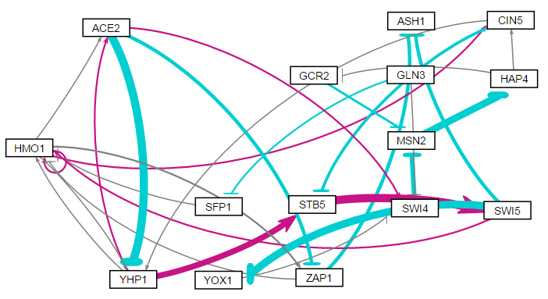
Random 23

Slide 49
Random 23
id | indegree | outdegree | degree | weighted indegree | weighted outdegree | weighted degree | eccentricity | closnesscentrality | harmonicclosnesscentrality | betweenesscentrality | modularity_class | pageranks | componentnumber | strongcompnum | clustering | eigencentrality
ACE2 | 2 | 3 | 5 | 0.489394 | -7.73618 | -7.24679 | 4 | 0.428571 | 0.541667 | 26.83333 | 0 | 0.055452 | 0 | 1 | 0.333333 | 0.682727
ASH1 | 2 | 0 | 2 | -4.54796 | 0 | -4.54796 | 0 | 0 | 0 | 0 | 0 | 0.054142 | 0 | 0 | 0 | 0.307125
CIN5 | 2 | 2 | 4 | 0.67838 | -1.27985 | -0.60147 | 6 | 0.342857 | 0.454167 | 48.5 | 0 | 0.080744 | 0 | 1 | 0.25 | 0.421961
GCR2 | 1 | 1 | 2 | -0.11687 | -0.99403 | -1.1109 | 6 | 0.226415 | 0.3 | 1 | 0 | 0.061645 | 0 | 1 | 0.5 | 0.040895
GLN3 | 0 | 2 | 2 | 0 | -0.71113 | -0.71113 | 6 | 0.318182 | 0.413095 | 0 | 0 | 0.013067 | 0 | 3 | 0 | 0
HAP4 | 1 | 2 | 3 | -5.08571 | 0.121543 | -4.96417 | 4 | 0.363636 | 0.458333 | 49 | 0 | 0.114267 | 0 | 1 | 0.166667 | 0.073456
HMO1 | 5 | 5 | 10 | 0.711675 | 1.508299 | 2.219974 | 5 | 0.413793 | 0.572222 | 44.83333 | 1 | 0.112357 | 0 | 1 | 0.285714 | 1
MSN2 | 2 | 1 | 3 | -4.26605 | -5.08571 | -9.35176 | 5 | 0.27907 | 0.351389 | 50 | 0 | 0.11902 | 0 | 1 | 0.166667 | 0.1474
SFP1 | 1 | 1 | 2 | -0.59205 | -0.22101 | -0.81306 | 6 | 0.309524 | 0.389744 | 9 | 0 | 0.018621 | 0 | 2 | 0 | 0.003811
STB5 | 2 | 1 | 3 | 2.564131 | 6.186518 | 8.750649 | 6 | 0.324324 | 0.398611 | 29.33333 | 1 | 0.070649 | 0 | 1 | 0.166667 | 0.469264
SWI4 | 3 | 1 | 4 | 0.439143 | -3.27202 | -2.83288 | 6 | 0.24 | 0.313889 | 38 | 0 | 0.063046 | 0 | 1 | 0 | 0.292063
SWI5 | 1 | 3 | 4 | 6.186518 | -7.72472 | -1.53821 | 5 | 0.428571 | 0.551389 | 28.33333 | 1 | 0.073138 | 0 | 1 | 0 | 0.17883
YHP1 | 3 | 3 | 6 | -5.9797 | 4.653258 | -1.32644 | 5 | 0.413793 | 0.5375 | 35.5 | 1 | 0.082177 | 0 | 1 | 0.25 | 0.802668
YOX1 | 1 | 1 | 2 | -5.76355 | -0.10108 | -5.86462 | 7 | 0.214286 | 0.293254 | 8 | 0 | 0.033794 | 0 | 1 | 0 | 0.071148
ZAP1 | 2 | 2 | 4 | -1.68101 | -2.30755 | -3.98855 | 6 | 0.315789 | 0.436111 | 5.666667 | 0 | 0.047881 | 0 | 1 | 0.166667 | 0.635066

Slide 50
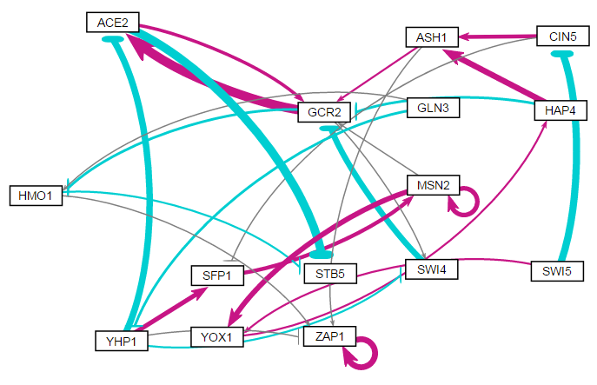
Random 24

Slide 51
Random 24
id | indegree | outdegree | degree | weighted indegree | weighted outdegree | weighted degree | eccentricity | closnesscentrality | harmonicclosnesscentrality | betweenesscentrality | modularity_class | pageranks | componentnumber | strongcompnum | clustering | eigencentrality
ACE2 | 2 | 2 | 4 | 1.73749 | -3.42274 | -1.68525 | 3 | 0.555556 | 0.666667 | 7 | 2 | 0.054909 | 0 | 3 | 0 | 0.593613
ASH1 | 2 | 2 | 4 | 4.551651 | 0.816929 | 5.368579 | 3 | 0.545455 | 0.638889 | 11.5 | 1 | 0.039292 | 0 | 4 | 0.083333 | 0.104409
CIN5 | 1 | 2 | 3 | -3.86349 | 1.557982 | -2.30551 | 4 | 0.392857 | 0.484848 | 6.5 | 0 | 0.019169 | 0 | 9 | 0 | 0.005758
GCR2 | 5 | 3 | 8 | -2.30774 | 4.535116 | 2.227371 | 2 | 0.714286 | 0.8 | 38 | 1 | 0.131855 | 0 | 3 | 0.033333 | 1
GLN3 | 0 | 2 | 2 | 0 | -0.70902 | -0.70902 | 6 | 0.363636 | 0.481944 | 0 | 2 | 0.013451 | 0 | 11 | 0 | 0
HAP4 | 1 | 2 | 3 | 0.53446 | 1.989116 | 2.523575 | 3 | 0.538462 | 0.619048 | 13.5 | 1 | 0.041615 | 0 | 5 | 0.166667 | 0.122684
HMO1 | 2 | 2 | 4 | -0.71465 | -0.33403 | -1.04868 | 1 | 1 | 1 | 11 | 2 | 0.056552 | 0 | 2 | 0 | 0.581537
MSN2 | 2 | 3 | 5 | 3.981856 | 4.696984 | 8.67884 | 3 | 0.473684 | 0.555556 | 17 | 1 | 0.049234 | 0 | 7 | 0.25 | 0.218009
SFP1 | 2 | 1 | 3 | 2.295872 | 1.792566 | 4.088438 | 4 | 0.344828 | 0.408333 | 12 | 1 | 0.025674 | 0 | 8 | 0 | 0.035669
STB5 | 2 | 0 | 2 | -5.10751 | 0 | -5.10751 | 0 | 0 | 0 | 0 | 2 | 0.060851 | 0 | 0 | 0 | 0.649708
SWI4 | 2 | 1 | 3 | -0.5594 | -3.25336 | -3.81276 | 3 | 0.454545 | 0.533333 | 1.5 | 2 | 0.054909 | 0 | 3 | 0 | 0.593613
SWI5 | 0 | 2 | 2 | 0 | -3.5604 | -3.5604 | 5 | 0.352941 | 0.454167 | 0 | 0 | 0.013451 | 0 | 12 | 0 | 0
YHP1 | 1 | 4 | 5 | -0.75851 | -1.98242 | -2.74093 | 5 | 0.44 | 0.601515 | 8.5 | 2 | 0.019169 | 0 | 10 | 0 | 0.005758
YOX1 | 2 | 1 | 3 | 2.793515 | 0.53446 | 3.327974 | 4 | 0.380952 | 0.447917 | 12.5 | 1 | 0.033123 | 0 | 6 | 0 | 0.169261
ZAP1 | 4 | 1 | 5 | 3.18857 | 3.110925 | 6.299495 | 0 | 0 | 0 | 0 | 1 | 0.386748 | 0 | 1 | 0.25 | 0.955237

Slide 52
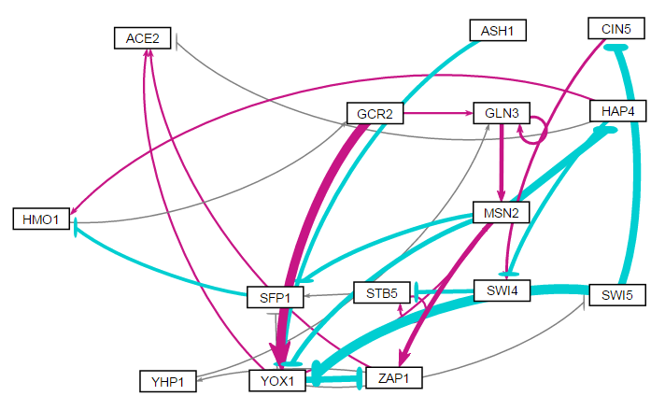
Random 25

Slide 53
Random 25
id | indegree | outdegree | degree | weighted indegree | weighted outdegree | weighted degree | eccentricity | closnesscentrality | harmonicclosnesscentrality | betweenesscentrality | modularity_class | pageranks | componentnumber | strongcompnum | clustering | eigencentrality
ACE2 | 3 | 0 | 3 | 1.159391 | 0 | 1.159391 | 0 | 0 | 0 | 0 | 1 | 0.060557 | 0 | 0 | 0.166667 | 0.987705
ASH1 | 0 | 1 | 1 | 0 | -1.81117 | -1.81117 | 5 | 0.35 | 0.413095 | 0 | 0 | 0.013432 | 0 | 2 | 0 | 0
CIN5 | 1 | 1 | 2 | -4.51868 | 1.150926 | -3.36775 | 8 | 0.183099 | 0.264469 | 6.333333 | 2 | 0.026227 | 0 | 1 | 0 | 0.205808
GCR2 | 1 | 2 | 3 | 0.035459 | 5.657906 | 5.693365 | 5 | 0.393939 | 0.483333 | 57 | 1 | 0.096335 | 0 | 1 | 0 | 0.35181
GLN3 | 3 | 2 | 5 | 1.889967 | 2.996806 | 4.886773 | 4 | 0.361111 | 0.416667 | 30.83333 | 3 | 0.145588 | 0 | 1 | 0.25 | 0.738219
HAP4 | 1 | 3 | 4 | -4.46349 | -1.60868 | -6.07217 | 5 | 0.342105 | 0.473077 | 19.66667 | 2 | 0.032974 | 0 | 1 | 0 | 0.388645
HMO1 | 2 | 1 | 3 | -1.09652 | 0.035459 | -1.06106 | 6 | 0.302326 | 0.367949 | 57 | 2 | 0.097516 | 0 | 1 | 0 | 0.708863
MSN2 | 2 | 4 | 6 | 2.497705 | -6.47019 | -3.97248 | 3 | 0.5 | 0.602564 | 47.66667 | 3 | 0.091963 | 0 | 1 | 0.1 | 0.766999
SFP1 | 3 | 1 | 4 | -1.89054 | -1.55702 | -3.44756 | 7 | 0.245283 | 0.313553 | 44 | 2 | 0.087905 | 0 | 1 | 0.166667 | 1
STB5 | 2 | 2 | 4 | -1.32911 | 0.950575 | -0.37854 | 7 | 0.220339 | 0.290476 | 24 | 2 | 0.090016 | 0 | 1 | 0.333333 | 0.377578
SWI4 | 2 | 1 | 3 | -0.8589 | -2.05668 | -2.91559 | 7 | 0.2 | 0.275275 | 24 | 2 | 0.045072 | 0 | 1 | 0 | 0.305251
SWI5 | 1 | 2 | 3 | -0.18149 | -10.2929 | -10.4744 | 4 | 0.40625 | 0.487179 | 16.33333 | 2 | 0.030107 | 0 | 1 | 0 | 0.397256
YHP1 | 1 | 1 | 2 | 0.182554 | 0.138907 | 0.321461 | 5 | 0.282609 | 0.341026 | 15 | 3 | 0.034537 | 0 | 1 | 0 | 0.395552
YOX1 | 4 | 5 | 9 | -5.10334 | -2.55443 | -7.65777 | 4 | 0.5 | 0.634615 | 78.16667 | 1 | 0.098123 | 0 | 1 | 0.071429 | 0.772437
ZAP1 | 2 | 2 | 4 | -1.05005 | 0.693421 | -0.35663 | 6 | 0.25 | 0.360256 | 17 | 3 | 0.049649 | 0 | 1 | 0.25 | 0.785902

Slide 54
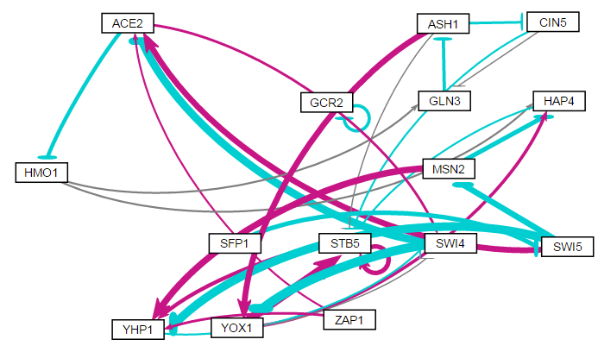
Random 26

Slide 55
Radom 26
id | indegree | outdegree | degree | weighted indegree | weighted outdegree | weighted degree | eccentricity | closnesscentrality | harmonicclosnesscentrality | betweenesscentrality | modularity_class | pageranks | componentnumber | strongcompnum | clustering | eigencentrality
ACE2 | 3 | 2 | 5 | -0.54969 | -0.81156 | -1.36125 | 4 | 0.409091 | 0.518519 | 43.66667 | 2 | 0.091087 | 0 | 0 | 0 | 0.36973
ASH1 | 1 | 3 | 4 | -1.36707 | 1.996686 | 0.629616 | 4 | 0.5 | 0.62037 | 23 | 0 | 0.044251 | 0 | 0 | 0.25 | 0.092065
CIN5 | 1 | 2 | 3 | -0.7914 | -0.38695 | -1.17835 | 5 | 0.36 | 0.485185 | 1 | 2 | 0.022531 | 0 | 0 | 0.333333 | 0.060427
GCR2 | 1 | 1 | 2 | -1.13934 | -1.13934 | -2.27869 | 0 | 0 | 0 | 0 | 1 | 0.066667 | 1 | 1 | 0 | 0.032097
GLN3 | 2 | 1 | 3 | 0.167869 | -1.36707 | -1.1992 | 5 | 0.36 | 0.438889 | 27 | 2 | 0.040273 | 0 | 0 | 0.166667 | 0.149385
HAP4 | 3 | 1 | 4 | -0.67609 | -0.44112 | -1.11721 | 8 | 0.225 | 0.329762 | 7.333333 | 2 | 0.063861 | 0 | 0 | 0.083333 | 0.336249
HMO1 | 1 | 2 | 3 | -1.50434 | 0.446521 | -1.05782 | 5 | 0.375 | 0.494444 | 33.33333 | 2 | 0.048739 | 0 | 0 | 0 | 0.196464
MSN2 | 1 | 2 | 3 | -2.57031 | 1.062386 | -1.50793 | 7 | 0.294118 | 0.442619 | 4 | 2 | 0.015242 | 0 | 2 | 0.166667 | 0.014649
SFP1 | 0 | 1 | 1 | 0 | -1.80342 | -1.80342 | 6 | 0.307692 | 0.384722 | 0 | 2 | 0.01 | 0 | 4 | 0 | 0
STB5 | 5 | 2 | 7 | 5.243578 | 3.365342 | 8.60892 | 7 | 0.257143 | 0.35291 | 19 | 0 | 0.196642 | 0 | 0 | 0.266667 | 1
SWI4 | 3 | 2 | 5 | 0.307381 | -8.52977 | -8.22238 | 5 | 0.391304 | 0.512963 | 44.66667 | 2 | 0.168543 | 0 | 0 | 0 | 0.694873
SWI5 | 1 | 3 | 4 | -1.80342 | -4.00844 | -5.81186 | 5 | 0.407407 | 0.540909 | 11 | 2 | 0.0185 | 0 | 3 | 0.083333 | 0.005049
YHP1 | 4 | 1 | 5 | 1.206622 | -0.28616 | 0.920465 | 6 | 0.310345 | 0.401852 | 29.33333 | 0 | 0.109537 | 0 | 0 | 0.05 | 0.548073
YOX1 | 2 | 3 | 5 | -1.91783 | 5.30371 | 3.385885 | 6 | 0.36 | 0.55 | 17.66667 | 0 | 0.094127 | 0 | 0 | 0.166667 | 0.410459
ZAP1 | 0 | 2 | 2 | 0 | 1.205138 | 1.205138 | 5 | 0.357143 | 0.47 | 0 | 0 | 0.01 | 0 | 5 | 0 | 0

Slide 56
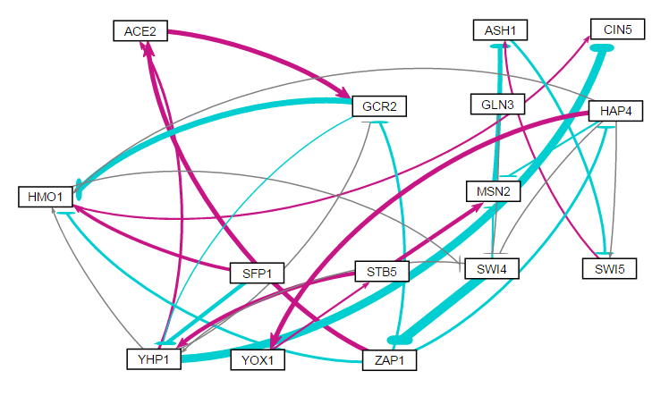
Random 27

Slide 57
Random 27
id | indegree | outdegree | degree | weighted indegree | weighted outdegree | weighted degree | eccentricity | closnesscentrality | harmonicclosnesscentrality | betweenesscentrality | modularity_class | pageranks | componentnumber | strongcompnum | clustering | eigencentrality
ACE2 | 2 | 1 | 3 | 3.43382 | 2.657622 | 6.091442 | 7 | 0.25 | 0.336905 | 0 | 4 | 0.036092 | 0 | 3 | 0.5 | 0.525232
ASH1 | 2 | 1 | 3 | -2.0765 | -0.84212 | -2.91862 | 1 | 1 | 1 | 6.5 | 1 | 0.239472 | 0 | 0 | 0 | 0.386756
CIN5 | 2 | 0 | 2 | -4.33958 | 0 | -4.33958 | 0 | 0 | 0 | 0 | 3 | 0.060916 | 0 | 2 | 0.5 | 0.874283
GCR2 | 3 | 2 | 5 | 1.553304 | -3.7192 | -2.16589 | 6 | 0.315789 | 0.436111 | 12 | 4 | 0.06677 | 0 | 3 | 0.333333 | 0.788377
GLN3 | 0 | 1 | 1 | 0 | -0.20801 | -0.20801 | 5 | 0.342105 | 0.4 | 0 | 2 | 0.013452 | 0 | 4 | 0 | 0
HAP4 | 1 | 5 | 6 | -1.21178 | 1.767607 | 0.555831 | 3 | 0.571429 | 0.680556 | 24 | 4 | 0.019895 | 0 | 3 | 0.133333 | 0.151194
HMO1 | 5 | 2 | 7 | -2.59923 | 0.190224 | -2.40901 | 5 | 0.363636 | 0.461111 | 43 | 3 | 0.073569 | 0 | 3 | 0.214286 | 1
MSN2 | 3 | 1 | 4 | 0.73236 | -2.52445 | -1.79209 | 2 | 0.666667 | 0.75 | 15.5 | 4 | 0.045502 | 0 | 1 | 0.083333 | 0.417919
SFP1 | 0 | 2 | 2 | 0 | -0.52494 | -0.52494 | 6 | 0.325 | 0.441026 | 0 | 3 | 0.013452 | 0 | 5 | 0.5 | 0
STB5 | 1 | 2 | 3 | 0.538598 | 4.009951 | 4.54855 | 6 | 0.363636 | 0.481944 | 11 | 4 | 0.027761 | 0 | 3 | 0 | 0.050402
SWI4 | 3 | 3 | 6 | -0.60941 | -6.3626 | -6.972 | 4 | 0.48 | 0.576389 | 59 | 3 | 0.059537 | 0 | 3 | 0.166667 | 0.58574
SWI5 | 2 | 1 | 3 | -0.69881 | 0.447952 | -0.25085 | 1 | 1 | 1 | 1 | 1 | 0.220211 | 0 | 0 | 0 | 0.290731
YHP1 | 4 | 4 | 8 | -0.18155 | -3.32258 | -3.50413 | 6 | 0.333333 | 0.519444 | 26.5 | 4 | 0.076215 | 0 | 3 | 0.119048 | 0.731703
YOX1 | 1 | 1 | 2 | 2.22359 | 0.538598 | 2.762188 | 6 | 0.307692 | 0.377778 | 9 | 4 | 0.016834 | 0 | 3 | 0 | 0.080492
ZAP1 | 1 | 4 | 5 | -5.79428 | -1.1375 | -6.93178 | 3 | 0.545455 | 0.638889 | 32.5 | 0 | 0.030321 | 0 | 3 | 0.25 | 0.297937

Slide 58
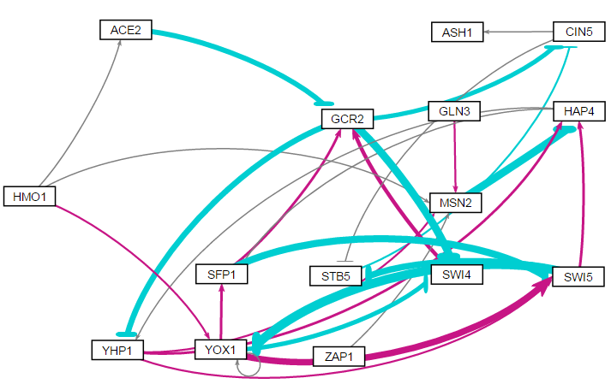
Random 28

Slide 59
Random 28
id | indegree | outdegree | degree | weighted indegree | weighted outdegree | weighted degree | eccentricity | closnesscentrality | harmonicclosnesscentrality | betweenesscentrality | modularity_class | pageranks | componentnumber | strongcompnum | clustering | eigencentrality
ACE2 | 1 | 1 | 2 | 0.018408 | -2.59281 | -2.5744 | 4 | 0.366667 | 0.424242 | 3.5 | 4 | 0.017533 | 0 | 3 | 0 | 0.004391
ASH1 | 1 | 0 | 1 | 0.124185 | 0 | 0.124185 | 0 | 0 | 0 | 0 | 0 | 0.064657 | 0 | 0 | 0 | 0.265501
CIN5 | 2 | 2 | 4 | -2.78562 | -0.07027 | -2.85589 | 1 | 1 | 1 | 16 | 0 | 0.119906 | 0 | 1 | 0 | 0.595709
GCR2 | 3 | 3 | 6 | 0.084239 | -9.36726 | -9.28302 | 3 | 0.526316 | 0.616667 | 41.16667 | 1 | 0.10878 | 0 | 2 | 0 | 0.636188
GLN3 | 0 | 1 | 1 | 0 | 0.384598 | 0.384598 | 6 | 0.255814 | 0.330303 | 0 | 3 | 0.013661 | 0 | 4 | 0 | 0
HAP4 | 3 | 2 | 5 | -2.09942 | 0.260082 | -1.83933 | 4 | 0.416667 | 0.508333 | 36 | 4 | 0.123209 | 0 | 2 | 0.25 | 0.920938
HMO1 | 0 | 3 | 3 | 0 | 0.603539 | 0.603539 | 4 | 0.461538 | 0.5625 | 0 | 4 | 0.013661 | 0 | 5 | 0 | 0
MSN2 | 4 | 1 | 5 | 0.954076 | -4.16163 | -3.20756 | 5 | 0.3125 | 0.386667 | 21.5 | 3 | 0.068203 | 0 | 2 | 0.1 | 0.330026
SFP1 | 2 | 2 | 4 | 0.74358 | -3.03761 | -2.29403 | 3 | 0.5 | 0.566667 | 25.5 | 1 | 0.077263 | 0 | 2 | 0.25 | 0.762124
STB5 | 2 | 1 | 3 | -3.4993 | -0.57585 | -4.07516 | 2 | 0.666667 | 0.75 | 4.666667 | 2 | 0.088797 | 0 | 1 | 0 | 0.701356
SWI4 | 2 | 1 | 3 | -6.32726 | 1.945769 | -4.38149 | 4 | 0.357143 | 0.416667 | 2.166667 | 1 | 0.055725 | 0 | 2 | 0 | 0.638628
SWI5 | 3 | 3 | 6 | -0.08418 | -7.48032 | -7.5645 | 3 | 0.5 | 0.6 | 23.33333 | 4 | 0.085189 | 0 | 2 | 0.2 | 1
YHP1 | 2 | 3 | 5 | -2.66277 | 1.845544 | -0.81723 | 4 | 0.454545 | 0.575 | 25 | 4 | 0.09684 | 0 | 2 | 0.166667 | 0.706173
YOX1 | 3 | 4 | 7 | -4.54614 | 2.074436 | -2.4717 | 4 | 0.434783 | 0.566667 | 7.166667 | 4 | 0.052915 | 0 | 2 | 0.3 | 0.787535
ZAP1 | 0 | 1 | 1 | 0 | 0.091592 | 0.091592 | 6 | 0.255814 | 0.330303 | 0 | 3 | 0.013661 | 0 | 6 | 0 | 0

Slide 60
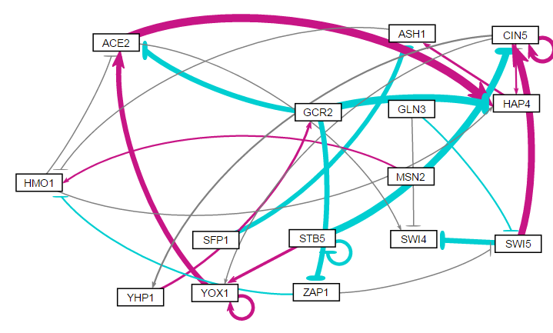
Random 29

Slide 61
Random 29
id | indegree | outdegree | degree | weighted indegree | weighted outdegree | weighted degree | eccentricity | closnesscentrality | harmonicclosnesscentrality | betweenesscentrality | modularity_class | pageranks | componentnumber | strongcompnum | clustering | eigencentrality
ACE2 | 3 | 2 | 5 | -0.03571 | 4.112279 | 4.076573 | 6 | 0.333333 | 0.461667 | 18 | 4 | 0.115183 | 0 | 1 | 0.1 | 0.637703
ASH1 | 2 | 1 | 3 | -1.58985 | -0.144 | -1.73385 | 7 | 0.27027 | 0.367619 | 18 | 1 | 0.093613 | 0 | 1 | 0.166667 | 0.463928
CIN5 | 4 | 4 | 8 | 1.781358 | 2.479487 | 4.260845 | 4 | 0.454545 | 0.575 | 64 | 4 | 0.128393 | 0 | 1 | 0.233333 | 1
GCR2 | 1 | 3 | 4 | 0.644161 | -8.43602 | -7.79186 | 3 | 0.526316 | 0.616667 | 29 | 2 | 0.050522 | 0 | 1 | 0.083333 | 0.209121
GLN3 | 0 | 2 | 2 | 0 | -0.3633 | -0.3633 | 5 | 0.314286 | 0.422727 | 0 | 3 | 0.014772 | 0 | 2 | 0.5 | 0
HAP4 | 4 | 2 | 6 | 0.982617 | 0.499748 | 1.482365 | 5 | 0.37037 | 0.486667 | 57 | 4 | 0.155991 | 0 | 1 | 0.15 | 0.994954
HMO1 | 3 | 2 | 5 | 0.010768 | 0.024163 | 0.034931 | 6 | 0.344828 | 0.478333 | 32 | 4 | 0.119327 | 0 | 1 | 0.1 | 0.267467
MSN2 | 0 | 1 | 1 | 0 | 0.507096 | 0.507096 | 7 | 0.275 | 0.364502 | 0 | 4 | 0.014772 | 0 | 3 | 0 | 0
SFP1 | 0 | 1 | 1 | 0 | -2.11563 | -2.11563 | 8 | 0.229167 | 0.31829 | 0 | 5 | 0.014772 | 0 | 4 | 0 | 0
STB5 | 1 | 3 | 4 | -1.27008 | -3.48544 | -4.75552 | 5 | 0.366667 | 0.472727 | 0 | 0 | 0.020613 | 0 | 5 | 0.5 | 0.02939
SWI4 | 3 | 0 | 3 | -2.53645 | 0 | -2.53645 | 0 | 0 | 0 | 0 | 6 | 0.084171 | 0 | 0 | 0.166667 | 0.342294
SWI5 | 2 | 2 | 4 | -0.24523 | 0.816488 | 0.571256 | 4 | 0.4 | 0.5 | 14 | 4 | 0.033416 | 0 | 1 | 0.083333 | 0.053887
YHP1 | 1 | 1 | 2 | 0.198514 | 0.644161 | 0.842675 | 4 | 0.384615 | 0.441667 | 32 | 2 | 0.042066 | 0 | 1 | 0 | 0.467862
YOX1 | 3 | 2 | 5 | 2.338264 | 3.648167 | 5.986431 | 7 | 0.27027 | 0.367619 | 7 | 4 | 0.083307 | 0 | 1 | 0.333333 | 0.901979
ZAP1 | 1 | 2 | 3 | -2.47837 | -0.38722 | -2.86559 | 4 | 0.434783 | 0.525 | 13 | 7 | 0.029079 | 0 | 1 | 0 | 0.093789

Slide 62
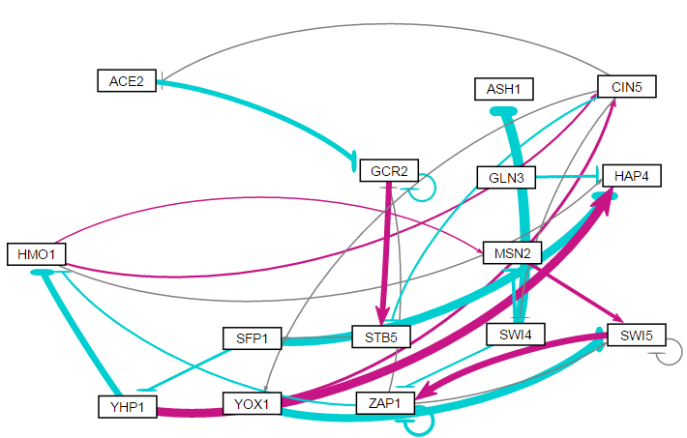
Random 30

Slide 63
Random 30
id | indegree | outdegree | degree | weighted indegree | weighted outdegree | weighted degree | eccentricity | closnesscentrality | harmonicclosnesscentrality | betweenesscentrality | modularity_class | pageranks | componentnumber | strongcompnum | clustering | eigencentrality
ACE2 | 1 | 1 | 2 | -0.09629 | -2.06565 | -2.16194 | 8 | 0.191176 | 0.272711 | 5.5 | 1 | 0.027826 | 0 | 2 | 0 | 0.122489
ASH1 | 1 | 0 | 1 | -4.88428 | 0 | -4.88428 | 0 | 0 | 0 | 0 | 0 | 0.0255 | 0 | 1 | 0 | 0.065024
CIN5 | 2 | 4 | 6 | 1.15923 | -0.7171 | 0.442131 | 3 | 0.52 | 0.615385 | 58 | 1 | 0.047943 | 0 | 2 | 0 | 0.252102
GCR2 | 3 | 2 | 5 | -2.56851 | 2.230765 | -0.33775 | 7 | 0.213115 | 0.289927 | 24 | 4 | 0.11557 | 0 | 2 | 0.25 | 0.772926
GLN3 | 0 | 1 | 1 | 0 | -0.80718 | -0.80718 | 1 | 1 | 1 | 0 | 2 | 0.017623 | 0 | 3 | 0 | 0
HAP4 | 4 | 0 | 4 | -0.52093 | 0 | -0.52093 | 0 | 0 | 0 | 0 | 3 | 0.108935 | 0 | 0 | 0.166667 | 0.334159
HMO1 | 2 | 3 | 5 | -3.23557 | 0.744828 | -2.49074 | 4 | 0.448276 | 0.544872 | 69.5 | 1 | 0.065326 | 0 | 2 | 0.05 | 0.425115
MSN2 | 2 | 1 | 3 | -1.08831 | 1.323325 | 0.23501 | 6 | 0.245283 | 0.311538 | 9.5 | 4 | 0.044005 | 0 | 2 | 0 | 0.252102
SFP1 | 1 | 2 | 3 | 0.114596 | -4.62454 | -4.50994 | 5 | 0.288889 | 0.385897 | 41.5 | 4 | 0.082979 | 0 | 2 | 0.166667 | 0.202783
STB5 | 2 | 1 | 3 | 1.912908 | 0.114596 | 2.027504 | 6 | 0.240741 | 0.317949 | 39.5 | 4 | 0.076937 | 0 | 2 | 0 | 0.454477
SWI4 | 1 | 3 | 4 | -0.18099 | -6.59197 | -6.77296 | 5 | 0.371429 | 0.496154 | 18 | 1 | 0.027826 | 0 | 2 | 0 | 0.122489
SWI5 | 4 | 2 | 6 | -2.16482 | 2.993292 | 0.828469 | 5 | 0.302326 | 0.364103 | 18 | 4 | 0.160073 | 0 | 2 | 0.333333 | 1
YHP1 | 1 | 2 | 3 | -0.7384 | 1.211754 | 0.473352 | 4 | 0.351351 | 0.435897 | 38 | 3 | 0.052952 | 0 | 2 | 0.333333 | 0.093515
YOX1 | 1 | 2 | 3 | 0.173978 | -2.81797 | -2.64399 | 4 | 0.393939 | 0.474359 | 1 | 1 | 0.027826 | 0 | 2 | 0 | 0.122489
ZAP1 | 3 | 4 | 7 | 1.458832 | -1.65273 | -0.1939 | 4 | 0.419355 | 0.525641 | 35.5 | 4 | 0.118679 | 0 | 2 | 0.25 | 0.877511

Slide 64

Random 31

Slide 65
Random 31
id | indegree | outdegree | degree | weighted indegree | weighted outdegree | weighted degree | eccentricity | closnesscentrality | harmonicclosnesscentrality | betweenesscentrality | modularity_class | pageranks | componentnumber | strongcompnum | clustering | eigencentrality
ACE2 | 3 | 3 | 6 | 0.694047 | -5.15468 | -4.46063 | 3 | 0.5625 | 0.648148 | 36.16667 | 4 | 0.0687 | 0 | 3 | 0.1 | 0.471903
ASH1 | 1 | 2 | 3 | -3.31242 | -2.91805 | -6.23047 | 4 | 0.454545 | 0.541667 | 4.333333 | 0 | 0.026939 | 0 | 4 | 0.166667 | 0.014273
CIN5 | 3 | 4 | 7 | 3.474752 | -0.07845 | 3.396301 | 3 | 0.6 | 0.703704 | 39 | 6 | 0.173254 | 0 | 3 | 0.1 | 0.934929
GCR2 | 3 | 1 | 4 | -2.34589 | -1.05122 | -3.39711 | 1 | 1 | 1 | 11 | 1 | 0.101138 | 0 | 1 | 0.166667 | 1
GLN3 | 4 | 1 | 5 | 1.94488 | 0.012381 | 1.95726 | 4 | 0.391304 | 0.453704 | 16.5 | 6 | 0.098134 | 0 | 3 | 0 | 0.84679
HAP4 | 1 | 0 | 1 | -2.08766 | 0 | -2.08766 | 0 | 0 | 0 | 0 | 2 | 0.027706 | 0 | 2 | 0 | 0.145996
HMO1 | 1 | 0 | 1 | -1.05122 | 0 | -1.05122 | 0 | 0 | 0 | 0 | 3 | 0.103411 | 0 | 0 | 0 | 0.470653
MSN2 | 0 | 3 | 3 | 0 | 2.122046 | 2.122046 | 4 | 0.448276 | 0.544872 | 0 | 4 | 0.017431 | 0 | 7 | 0.166667 | 0
SFP1 | 1 | 2 | 3 | 1.449111 | -2.78747 | -1.33836 | 4 | 0.423077 | 0.507576 | 1.5 | 4 | 0.02237 | 0 | 6 | 0.166667 | 0.004743
STB5 | 1 | 1 | 2 | -0.82053 | -0.82053 | -1.64107 | 0 | 0 | 0 | 0 | 5 | 0.115557 | 1 | 8 | 0 | 0.032989
SWI4 | 2 | 3 | 5 | -1.70177 | 0.37602 | -1.32575 | 5 | 0.36 | 0.485185 | 5.833333 | 6 | 0.051489 | 0 | 3 | 0.25 | 0.470868
SWI5 | 3 | 2 | 5 | -2.32553 | 1.985427 | -0.34011 | 4 | 0.428571 | 0.527778 | 9.5 | 6 | 0.075978 | 0 | 3 | 0.166667 | 0.622366
YHP1 | 2 | 1 | 3 | 2.592206 | 0.562701 | 3.154906 | 4 | 0.409091 | 0.472222 | 3 | 6 | 0.047174 | 0 | 3 | 0.333333 | 0.383231
YOX1 | 2 | 4 | 6 | -2.88223 | 2.435807 | -0.44642 | 4 | 0.5 | 0.657407 | 14.66667 | 6 | 0.048349 | 0 | 3 | 0.066667 | 0.260716
ZAP1 | 1 | 1 | 2 | 0.58681 | -0.46944 | 0.117371 | 5 | 0.30303 | 0.37 | 1.5 | 4 | 0.02237 | 0 | 5 | 0 | 0.004743

